Slide 1
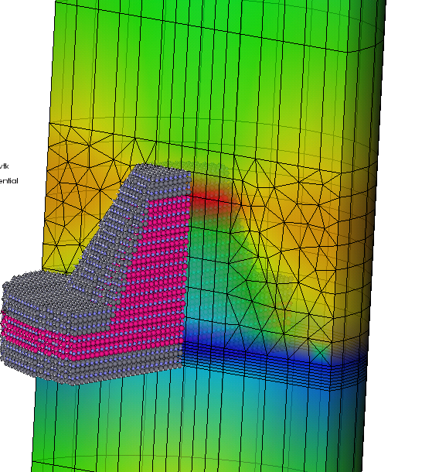


Coupling FEM and atomistic models for electronic device simulations:
The TiberCAD approach
Alessandro Pecchia
CNR - ISMN Institute for Nanostructured Materials
University of Roma “Tor Vergata”
M. Auf der Maur, G. Penazzi, F. Sacconi, G. Romano
A Gagliardi, F. Santoni, A. Di Carlo

Slide 2




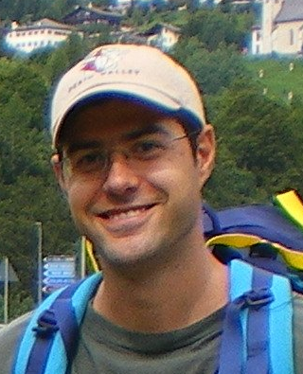
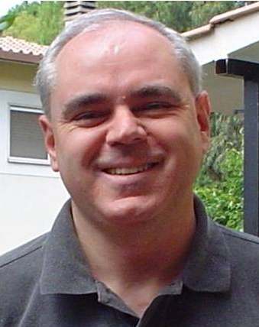


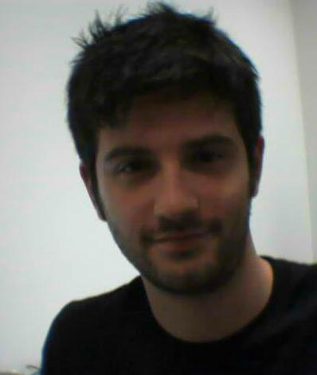

TiberCAD people
Prof. Aldo Di Carlo
Dr. A. Pecchia
Dr. M. Auf der Maur
Multiscale Device Simulator
http://www.tibercad.org
Dr. A. Gagliardi
Dr. F. Sacconi
Mr. F. Santoni
Mr. W. Rodrigues
Dr. G. Romano
Dr. G. Penazzi

Slide 3
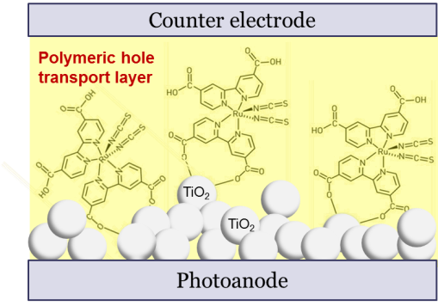
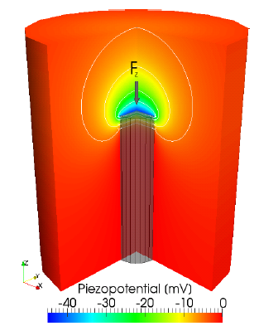
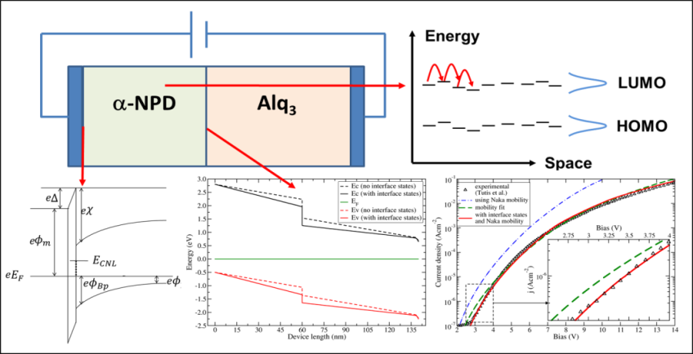
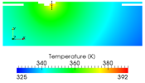
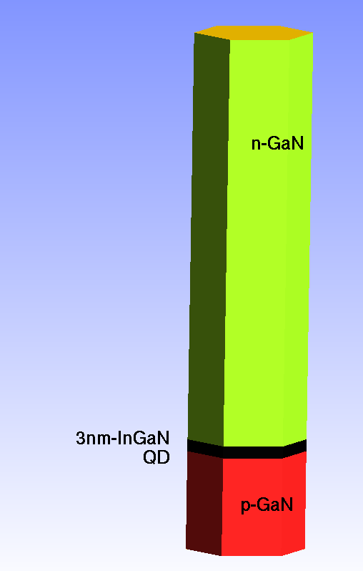
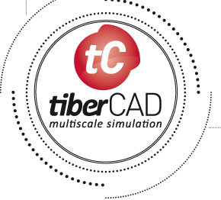
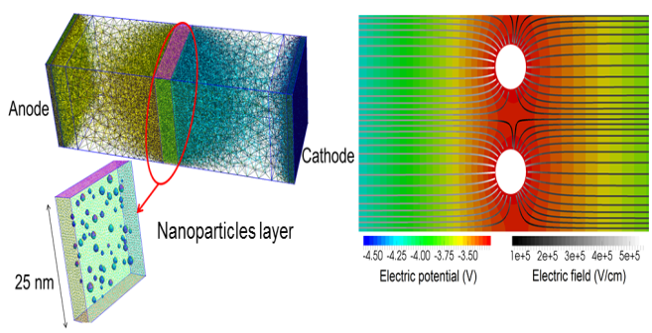
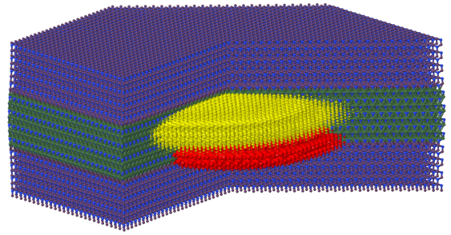
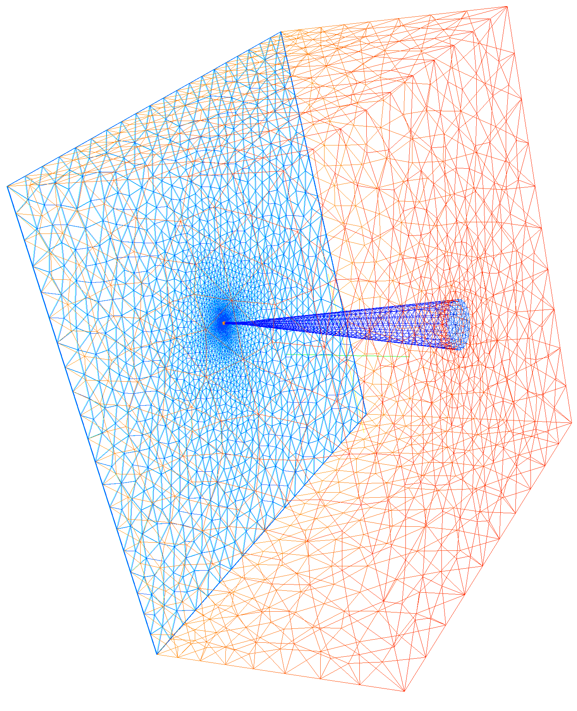
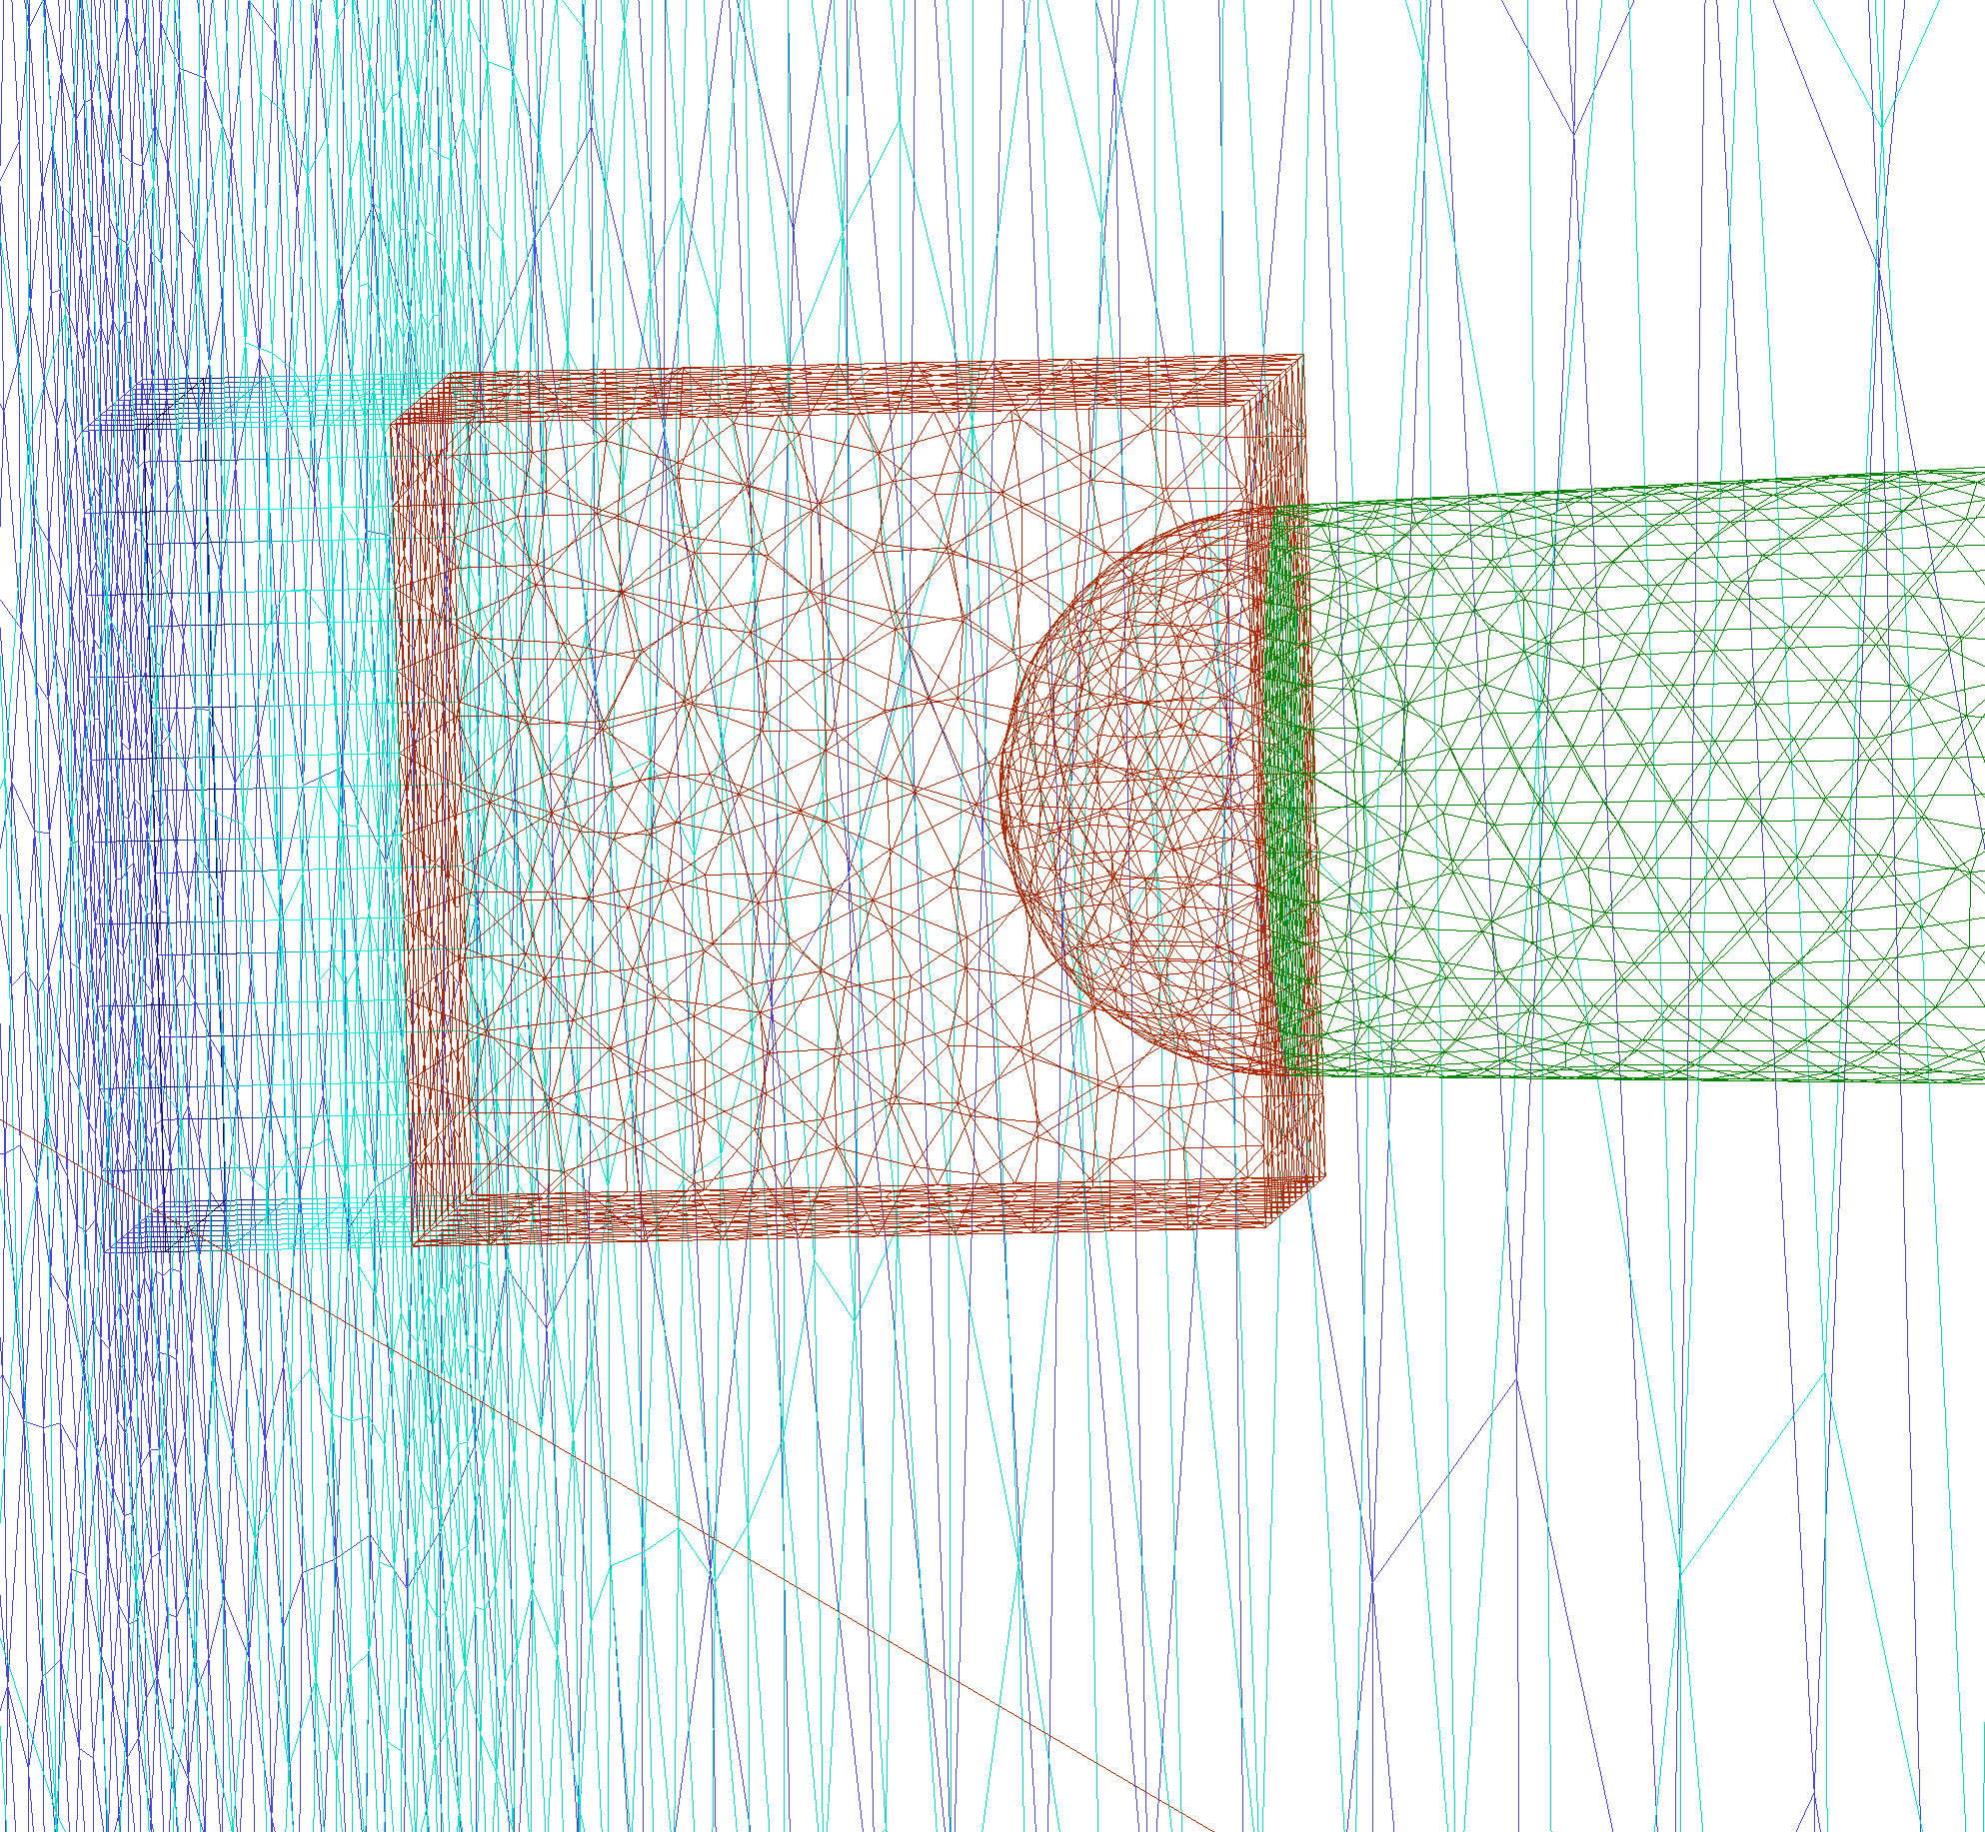
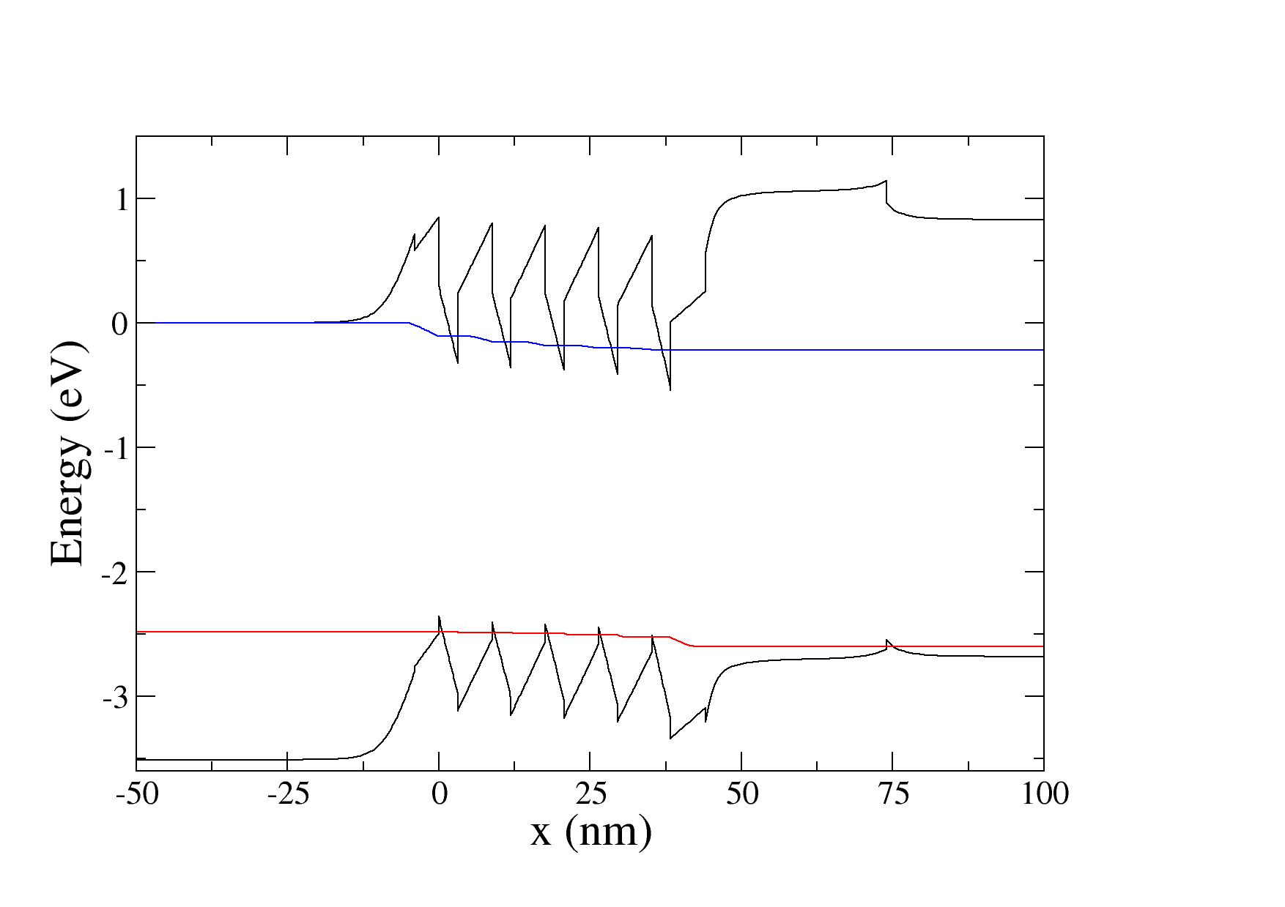
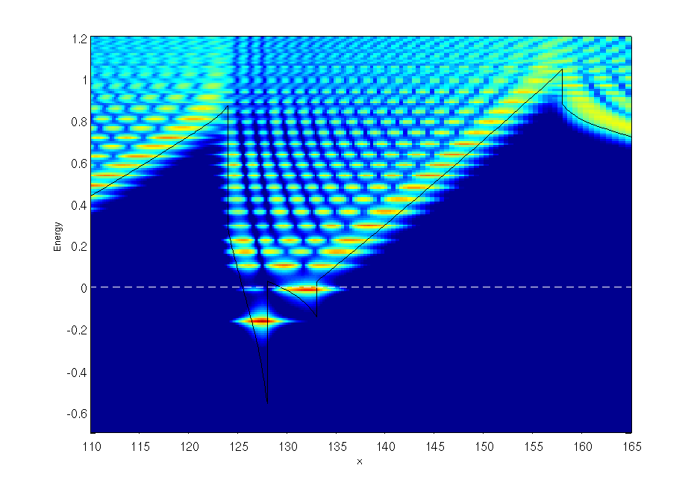
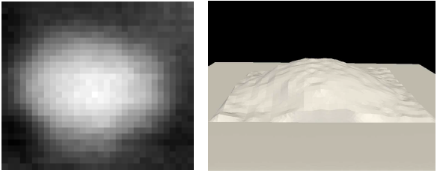
Applications
DSSC/OPV module
Piezoelectricity
Charge transport in organic semiconductors
Heat dissipation
Memristors
Nanofilaments
Inorganic LED (InGaN)
Quantum DOTs
1 nm
300 nm
Contact
Tunnel distance

Slide 4
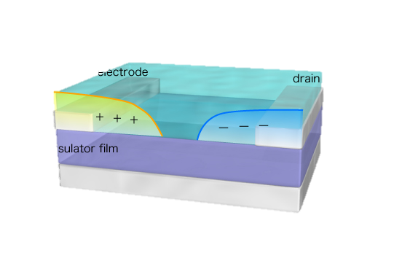
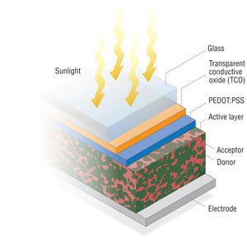
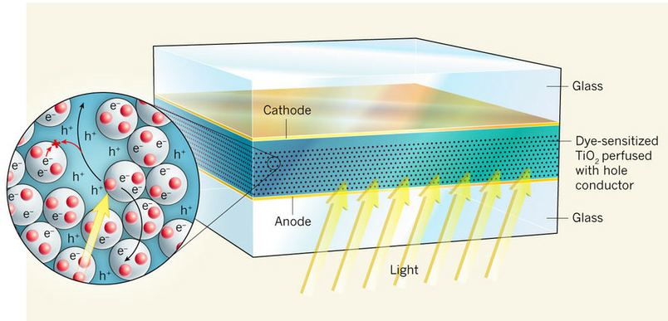
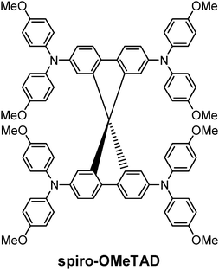
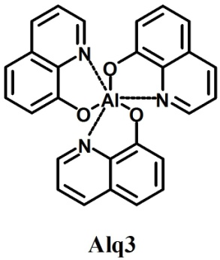
Organic transport in TiberCAD

Slide 5
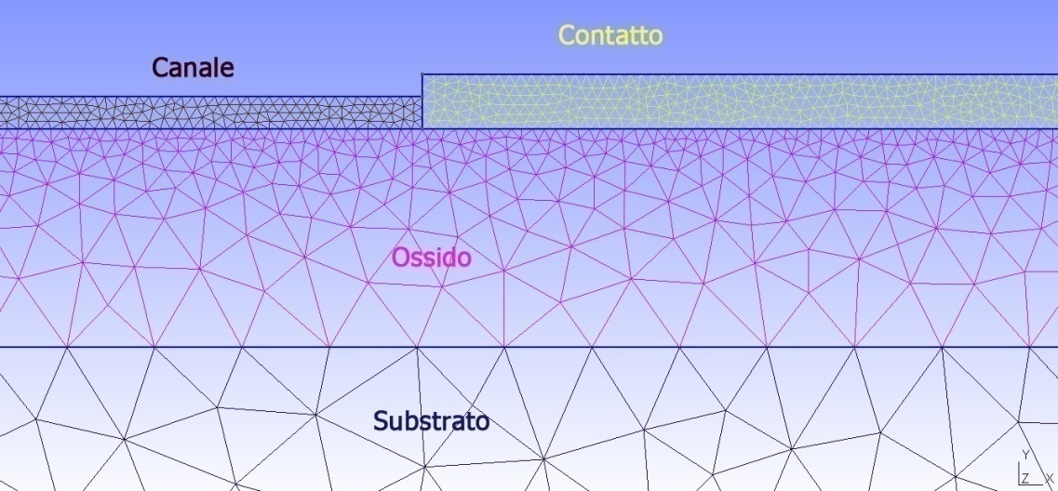
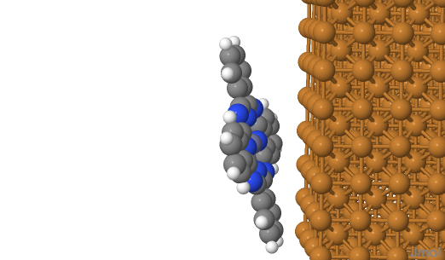
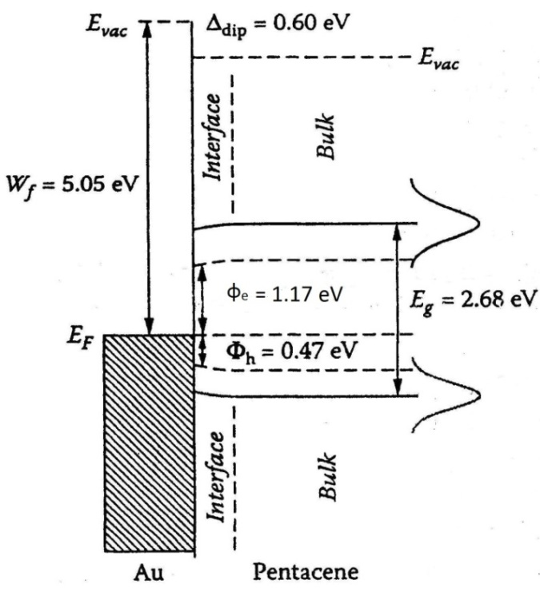
Organic devices
Challenge:
Interface problem
Local electric field
Morphology
Schottky

Slide 6
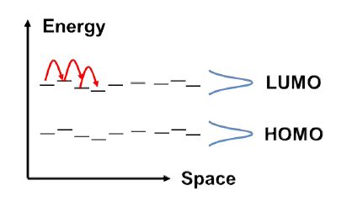
Model basics
Injection models
Thermionic Injection
Electron energy barrier
  Bulk model
Hole energy barrier
Thermionic Injection
Drift-Diffusion Model
F. Santoni, A. Gagliardi, M. auf der Maur, A. Di Carlo, Organic Electronics 15 (2014) 1557–1570
Notes:
Qui mettere un breve riassunto di come modelliamo la cosa

Slide 7
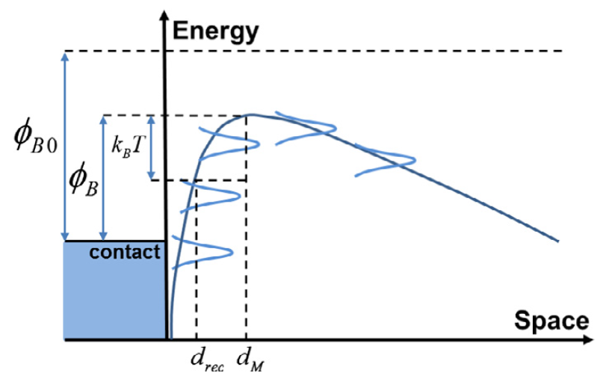
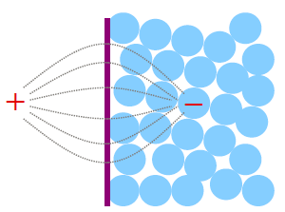
Injection Model
Current boundary condition:
C.R. Crowell, S.M. Sze, Solid State Electron. 9 (1966) 1035.
n₀ p₀ equilibrium densities
Scott-Malliaras model for charge injection
J.C. Scott, G.C. Malliaras, Chem. Phys.Lett. 299 (1999) 115.
Longevin recombination with image

Slide 8
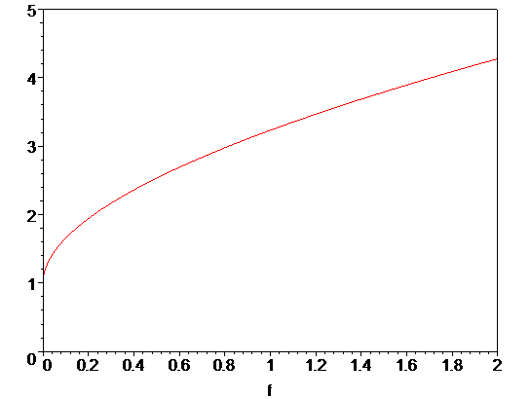
Field dependence
g(f)

Slide 9
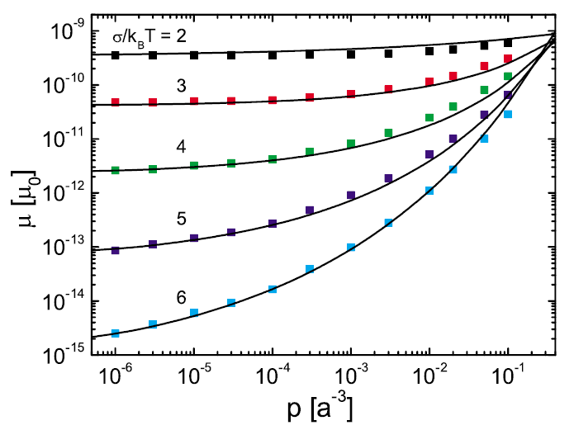
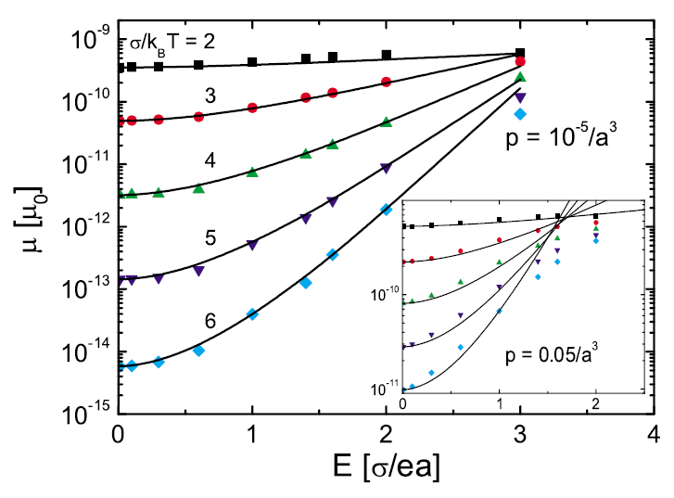
Mobility model
Mobility is dependent on carrier density n and electric field F
Mobility is strongly dependent on the energy disorder parameter σ
n
n
n
F
W. F. Pasveer et al., Phys. Rev. Lett. 94 (2005) 206601

Slide 10
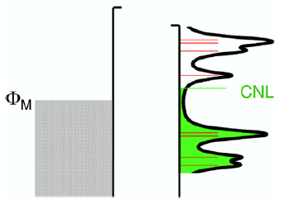
Induced Density of Interfacial States
The IDIS model applies when contact/organic chemical interactions are moderate but non-negligible
A.M. Cowley, S.M. Sze, J. Appl. Phys. 36 (1965) 3212.
DOS at the interface may originate from trap states or Metal-induced states (MIGS)
Vasquez, Flores, Kahn, Org. Elect. 8 (2007) 241
The charge neutrality level is like the
Fermi level of the organic at the interface
Assume constant gap DOS at the interface

Slide 11
Dipole shift
LUMO
LUMO
+
-
-
+
CNL
CNL
HOMO
HOMO
Self-consistent equation:

Slide 12
Determination of parameters
LUMO
+
-
CNL
HOMO

Slide 13
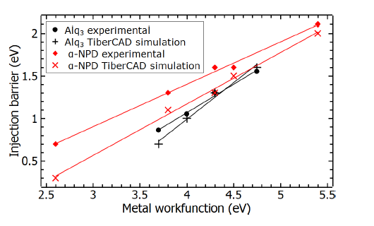
Referred to HOMO
S and b can be determined experimentally fitting different metal WF.

Slide 14
Determination of parameters
Referred to HOMO
S and b can be determined experimentally.

Slide 15
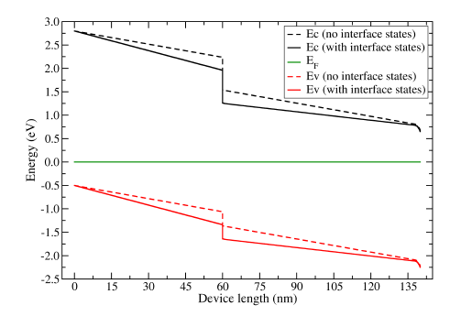
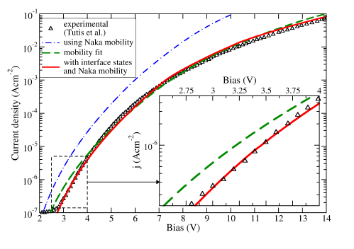
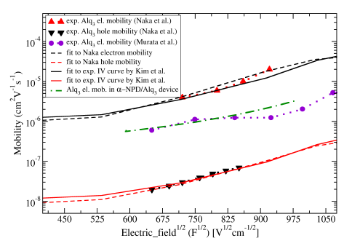
ITO/CuPc/α-NPD/Alq3/LiF/Al

Slide 16
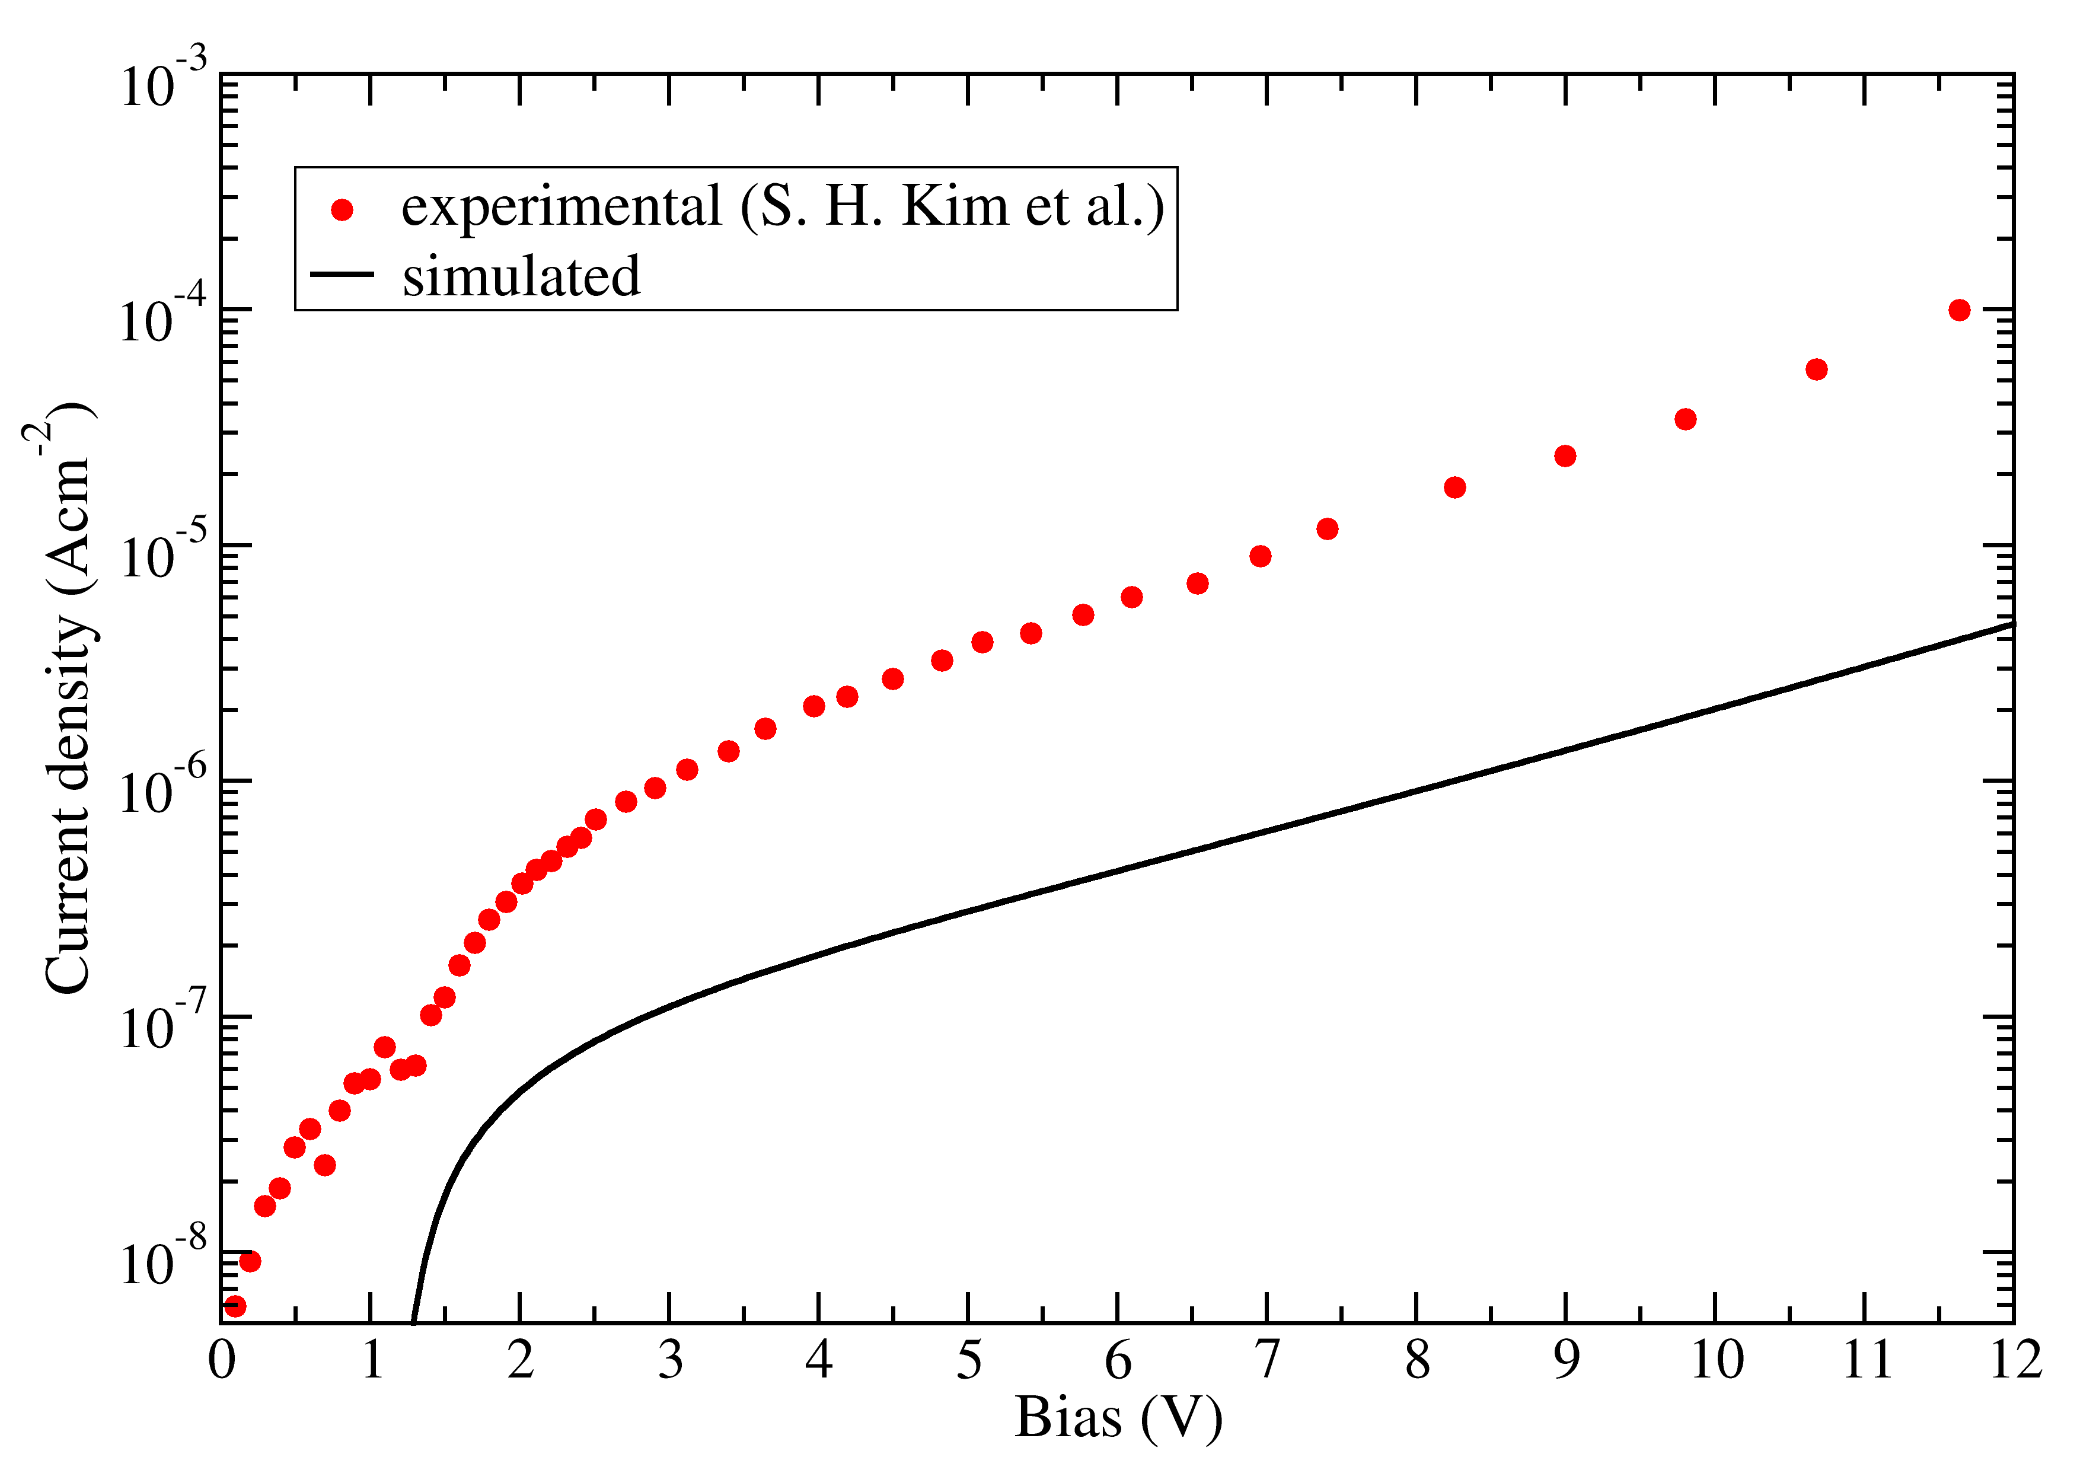
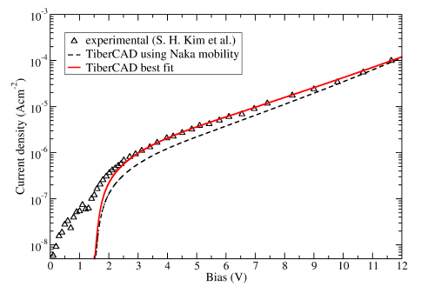
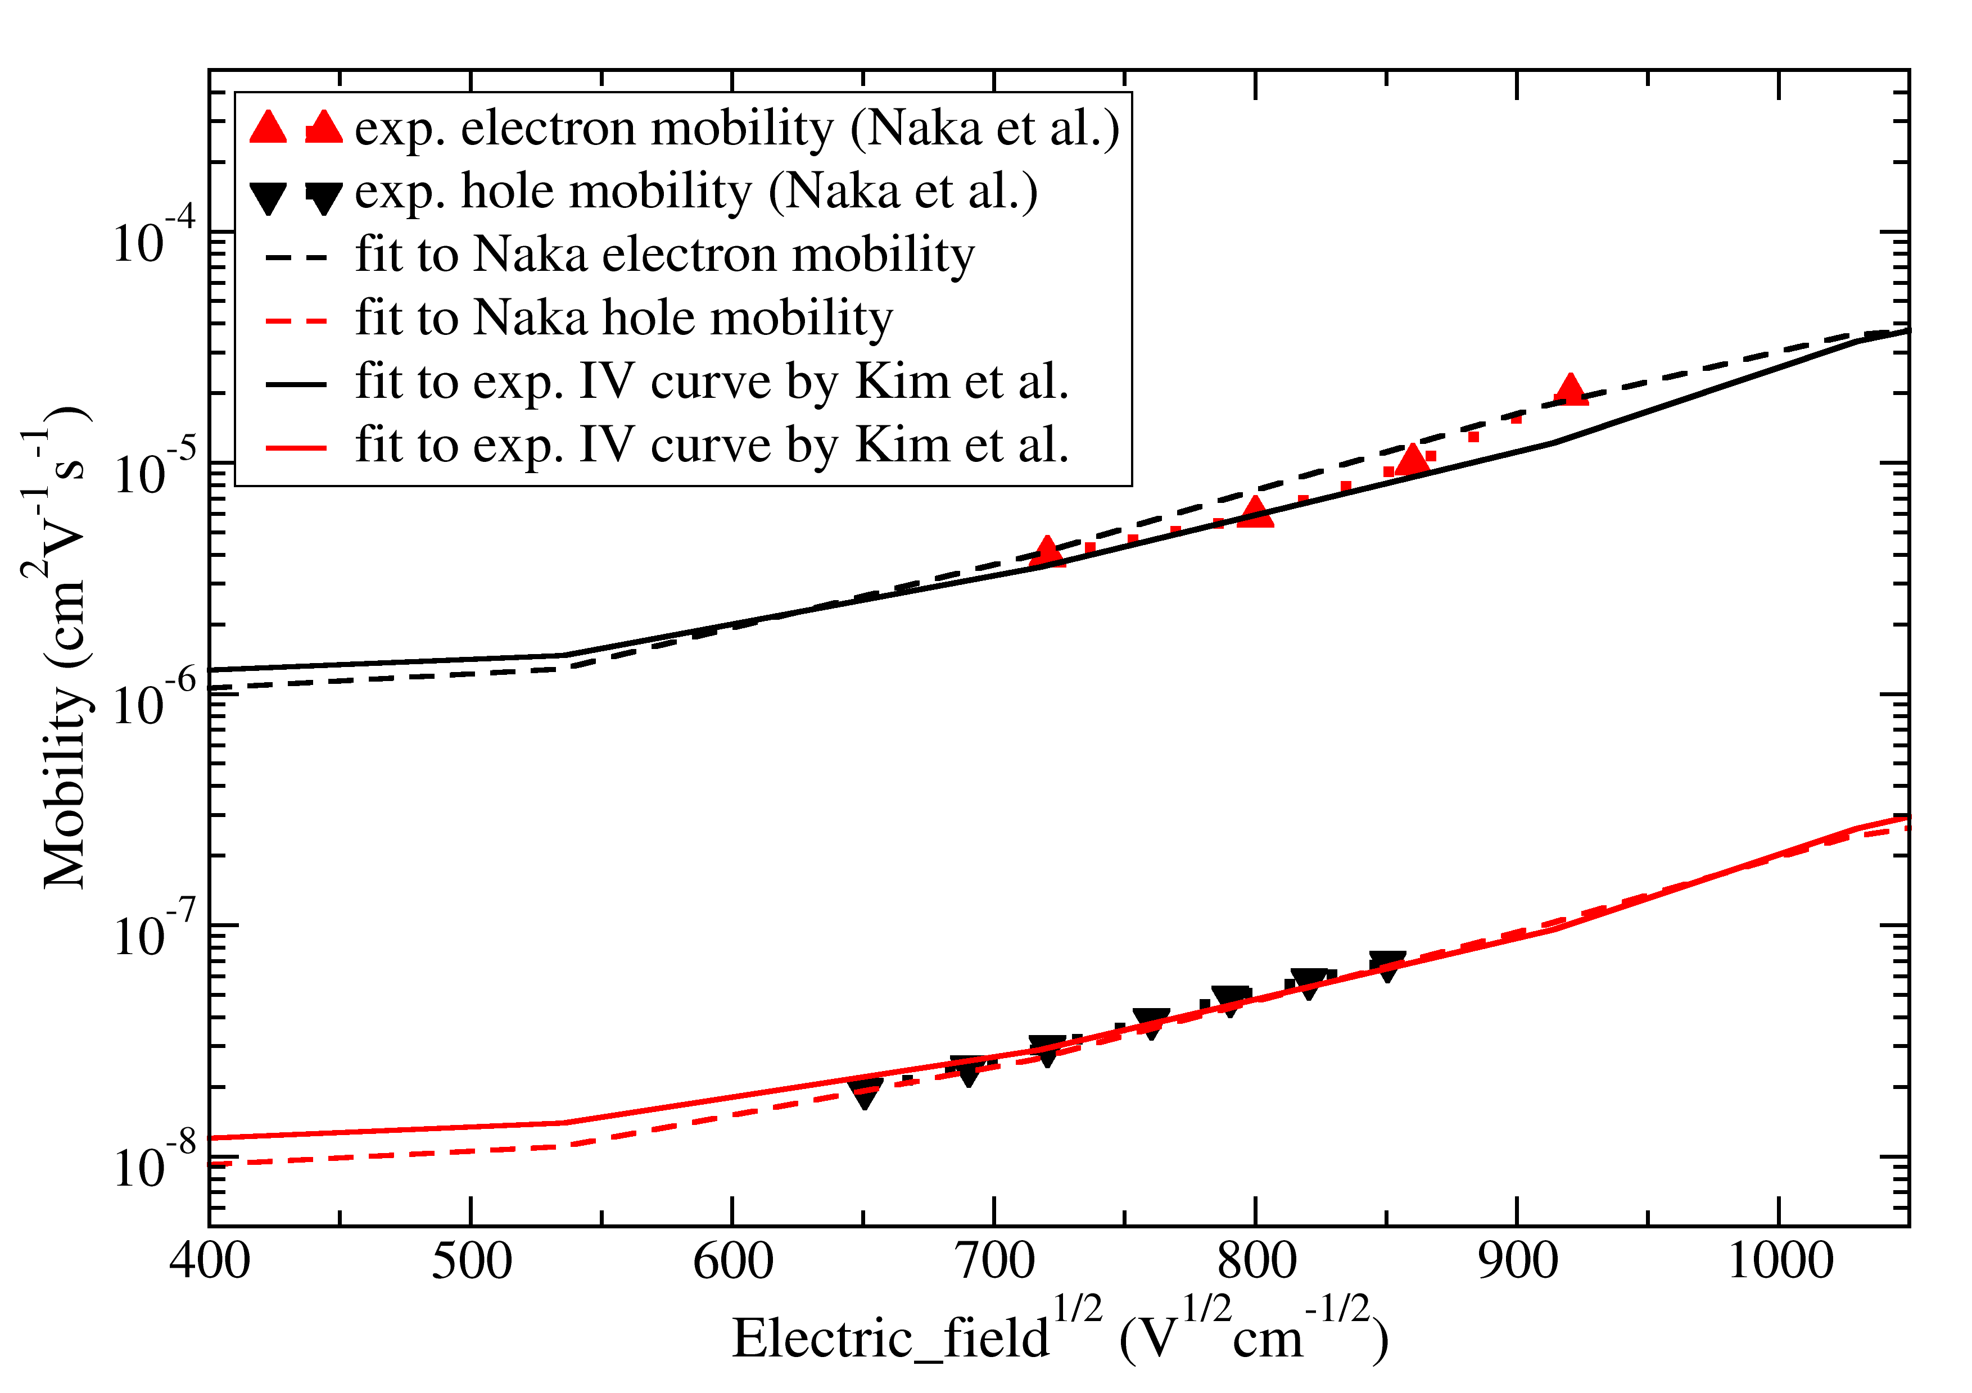
Importance of interfaces
ITO
Alq₃
Al
?
ITO/Alq₃/Al
Fitting mobility model alone is not enough.
I-V characteristics are determined also by the level alignment.

Slide 17
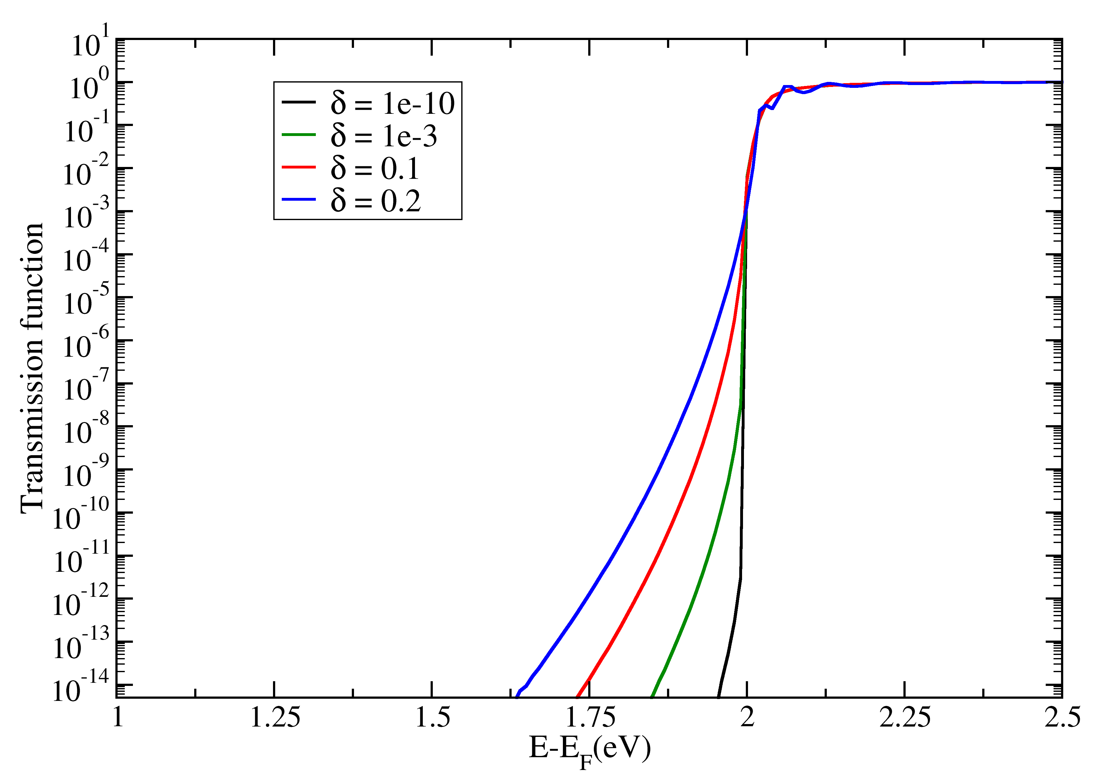
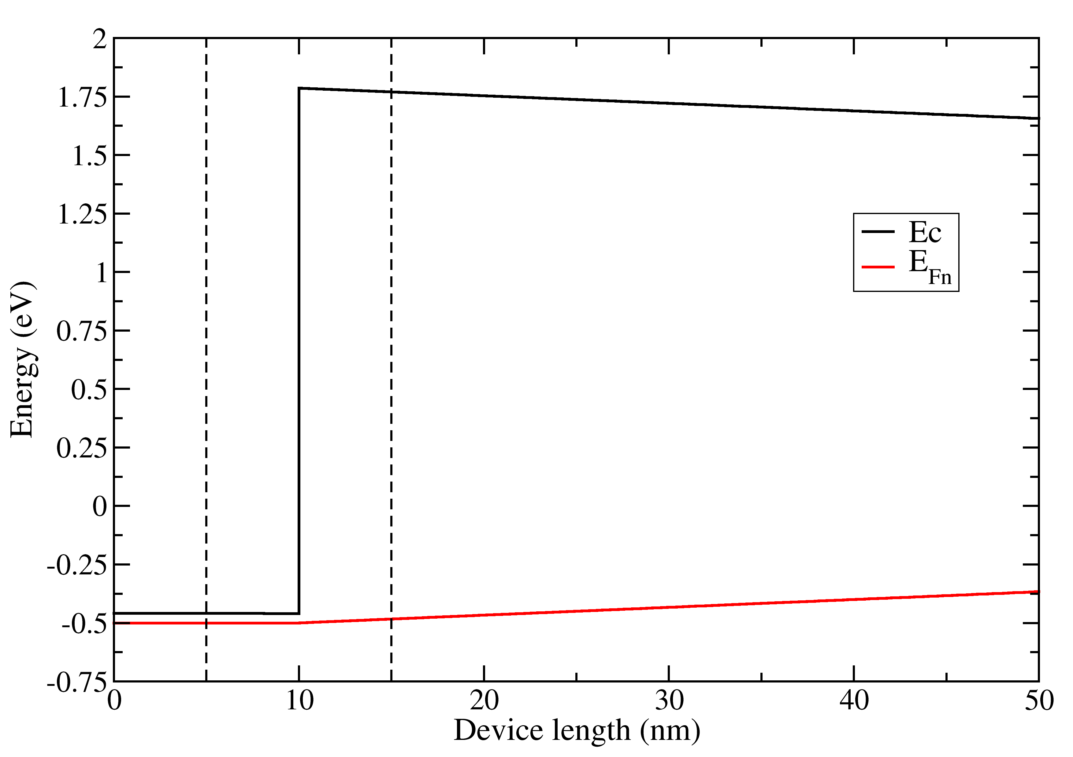
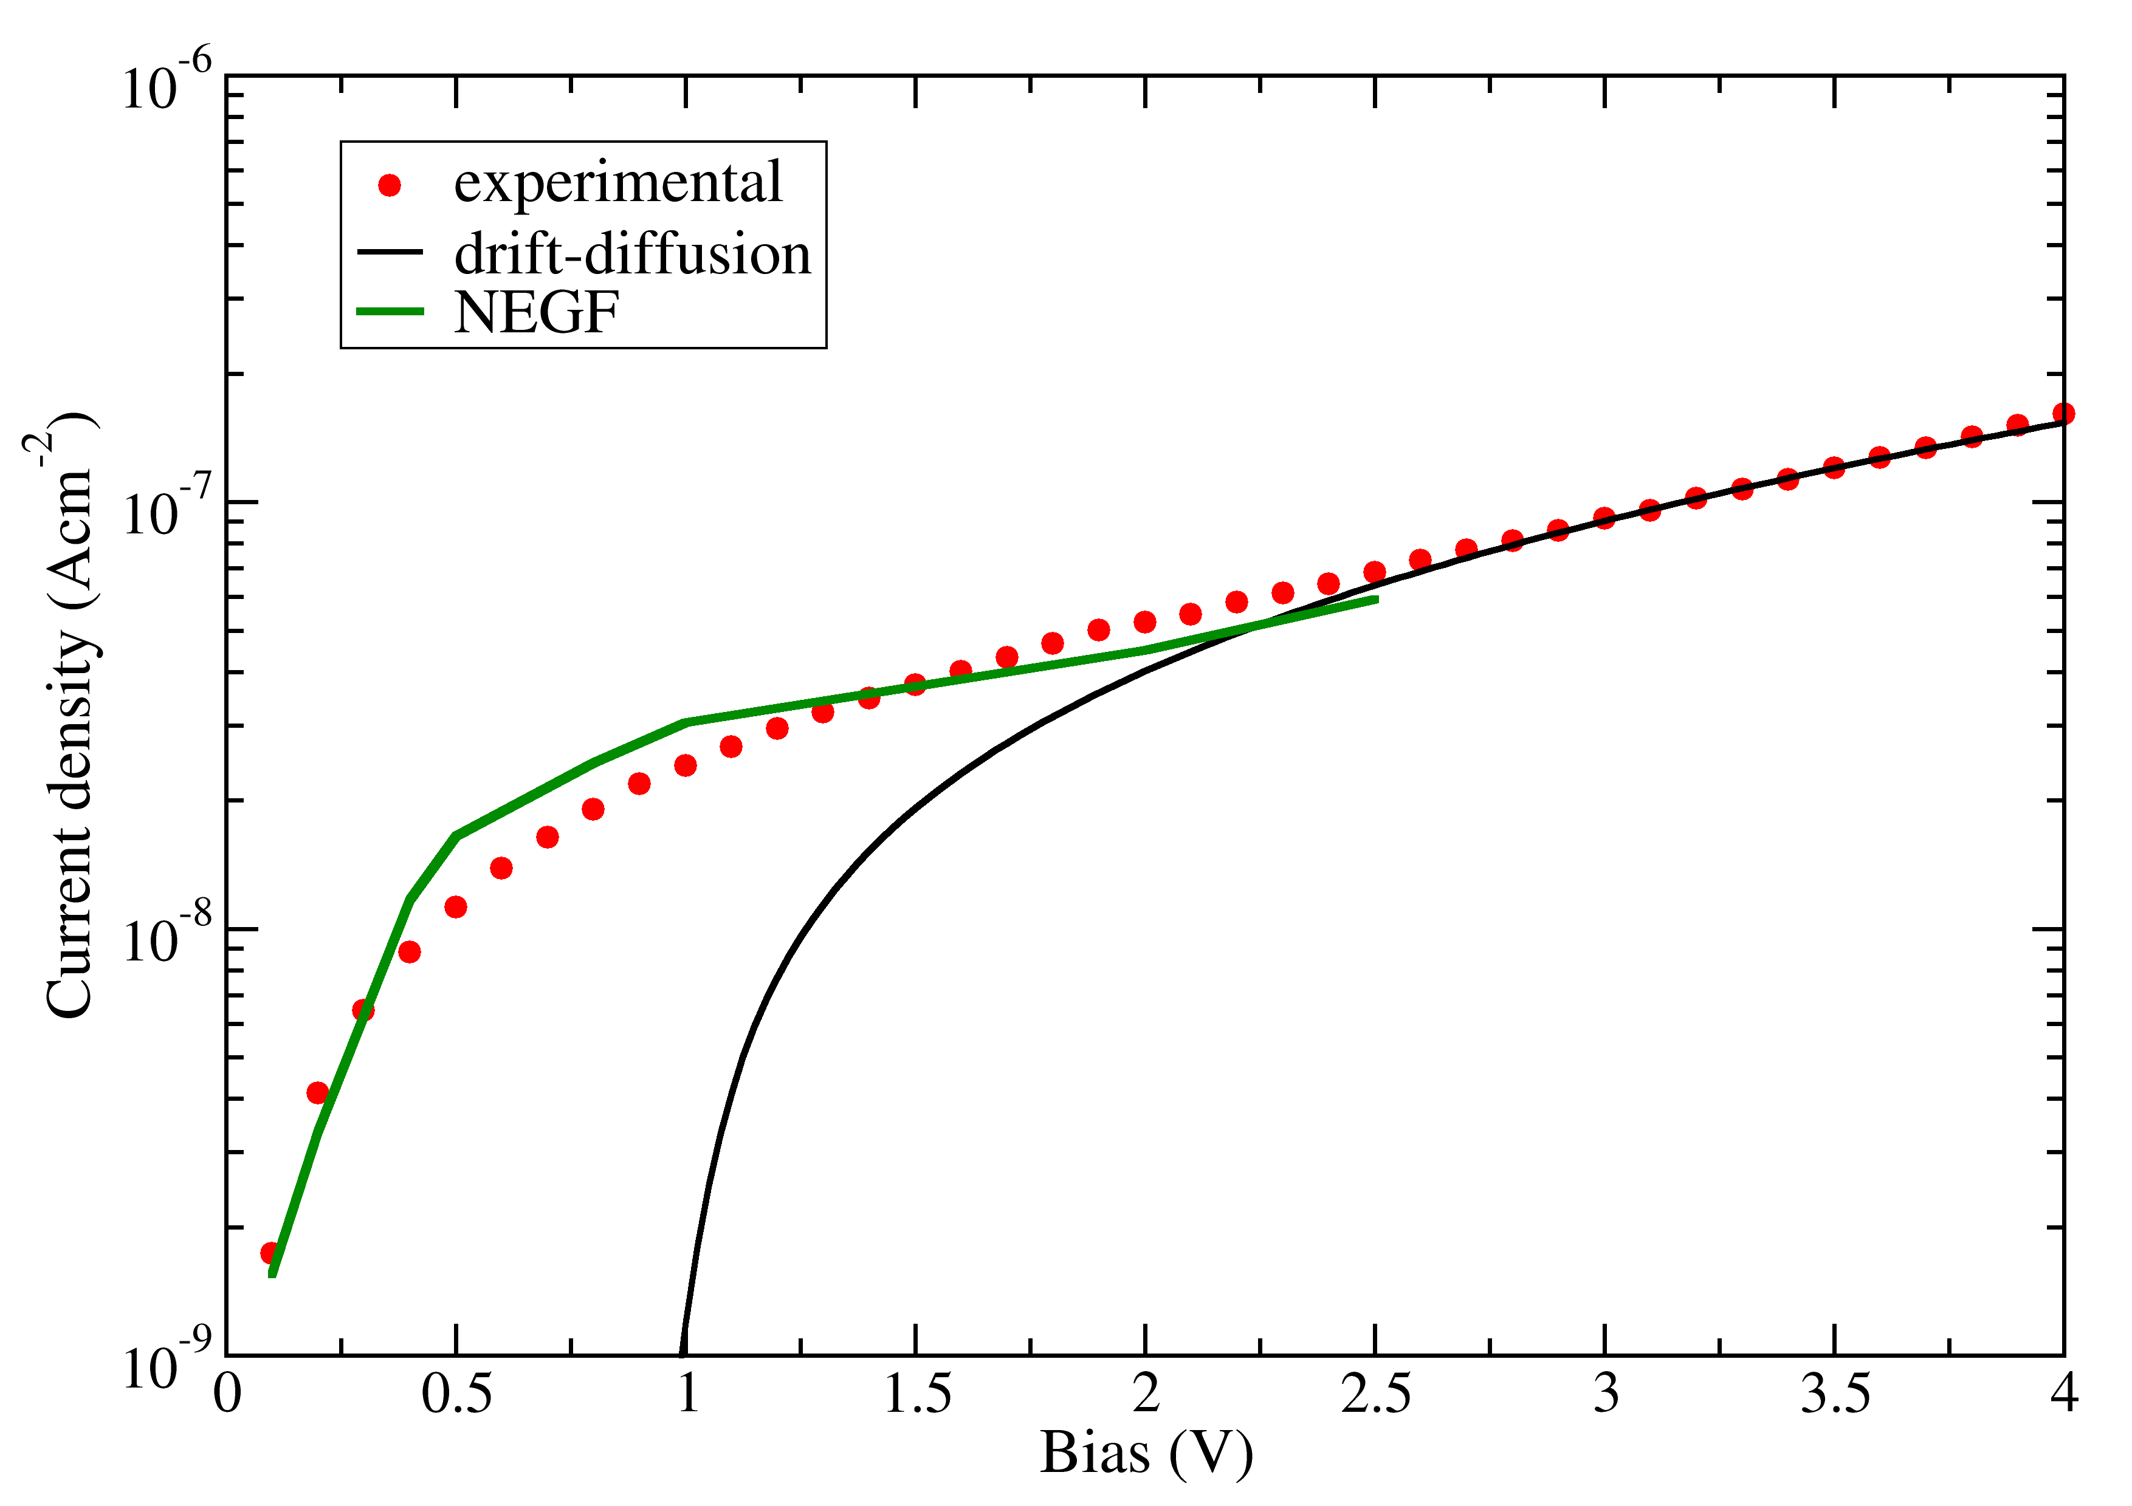
Trap-assisted tunneling
Gap dos can explain low bias current

Slide 18
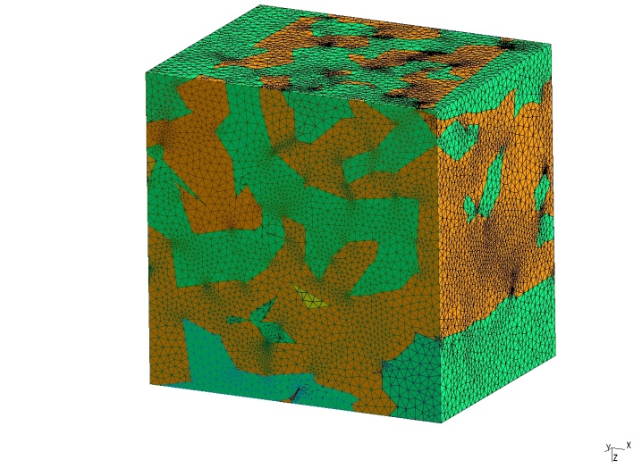
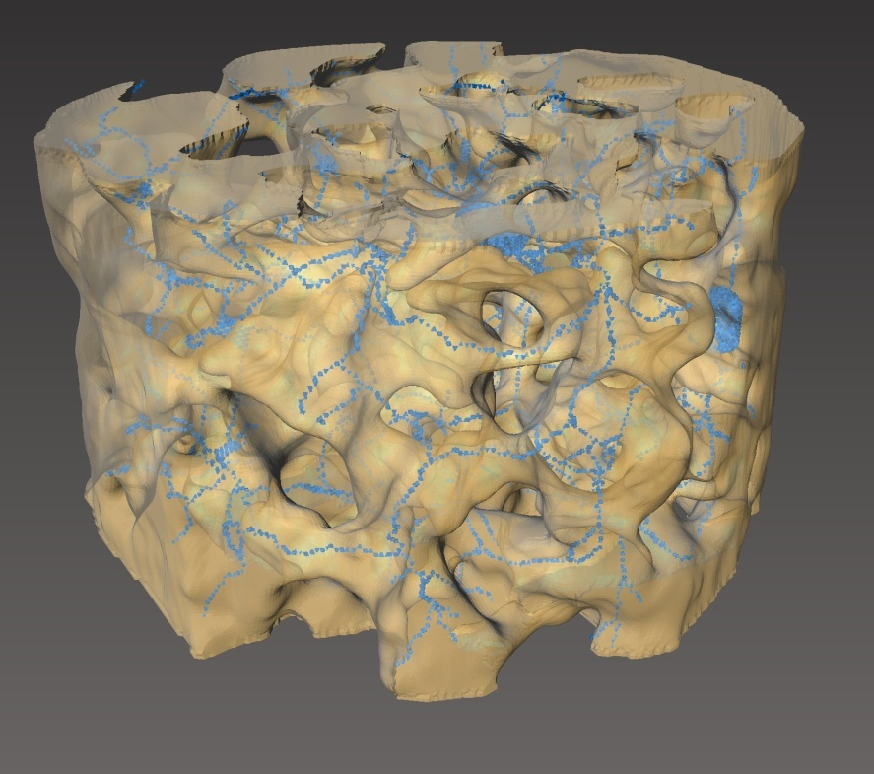
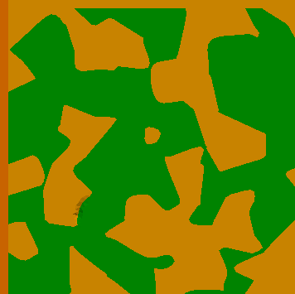
P3HT/TiO2 morphology
=
=
Paul A. Midgley & Rafal E. Dunin-Borkowski , “Electron tomography and holography in materials science”, Nature Materials 8, 271 - 280 (2009) .

Slide 19


Model of the blend
Buffer
(Eff. Mat.)
20 nm
Real Morphology
180 nm
Buffer
(Eff. Mat.)
20 nm
TiO₂
HTM
Eff.
Material
Eff.
Material
Anode
Light
Eff. Material
Eff. Material
3 μm

Slide 20
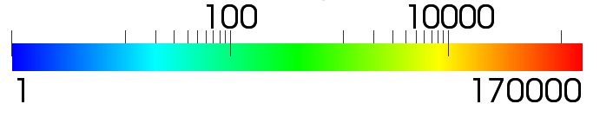
Effect of interface traps
Electric field intensity (V/cm)
No interface traps
Interface traps

Slide 21
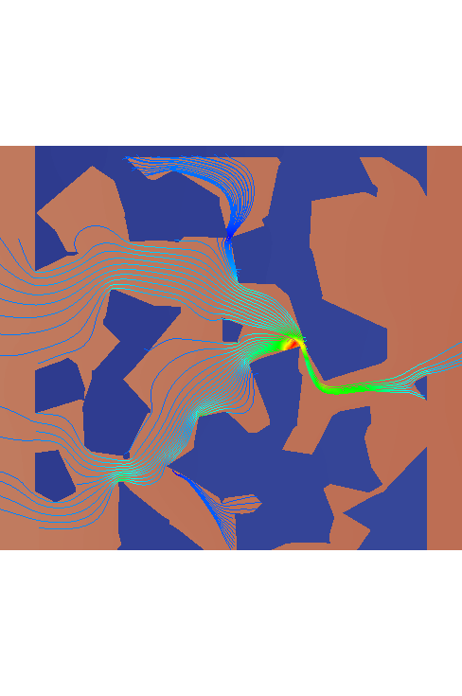
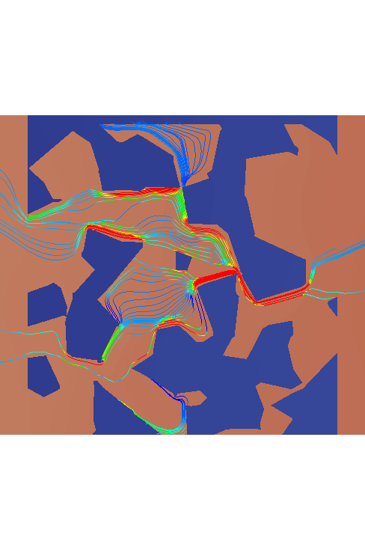
Effect of traps II
No traps
Traps at the interface

Slide 22
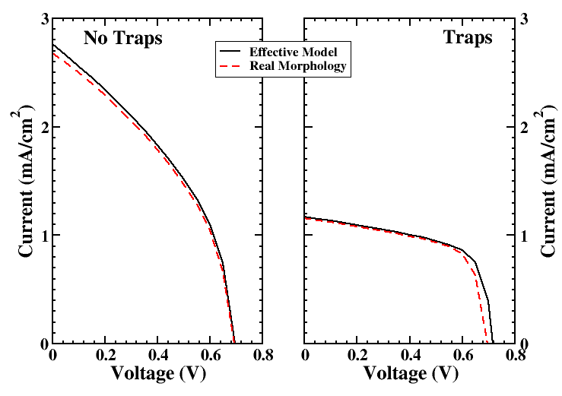
Effective model
Photoanode
Cathode
Effective (low mesh)
Effective (low mesh)
DOS renormalization
R and G renormalization

Slide 23

Conclusions
Multiscale/multiphysics is requested for simulation of real modern electronic devices where electronics, optics, chemistry are linked together
We have seen the most important physical models implemented in tiberCAD
We have discussed the basics of how to couple atomistic and classical simulations
Much effort is still needed to arrive at a true multiscale integration for transport simulations
Additional info about TiberCAD: http://www.tibercad.org
Download free trial version:
www.tiberlab.com
info@tiberlab.com

Slide 24

ELBE LAB ?
THANK YOU !

