Slide 1
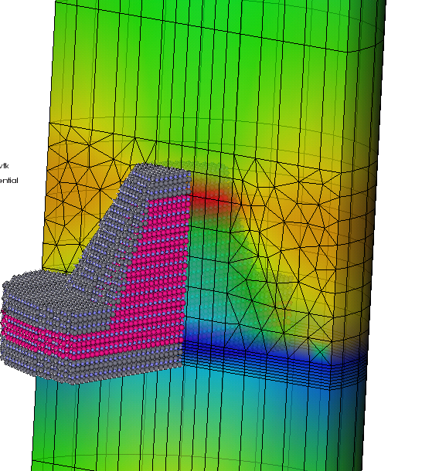


Coupling FEM and atomistic models for electronic device simulations:
The TiberCAD approach
Alessandro Pecchia
CNR - ISMN Institute for Nanostructured Materials
University of Roma “Tor Vergata”
M. Auf der Maur, G. Penazzi, F. Sacconi, G. Romano
A Gagliardi, F. Santoni, A. Di Carlo

Slide 2
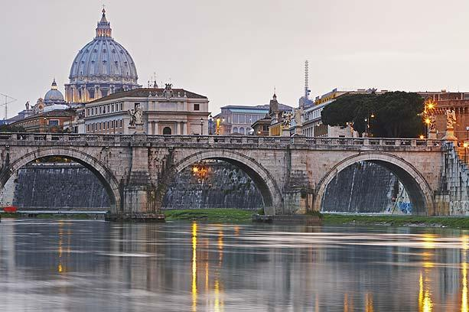
Tiber…

Slide 3
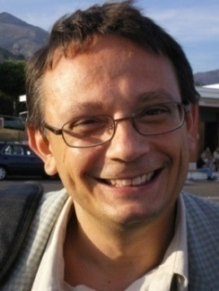
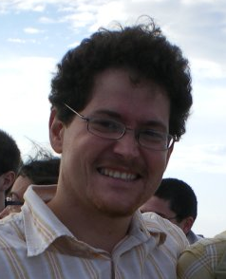


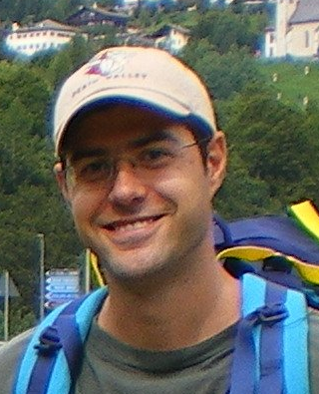
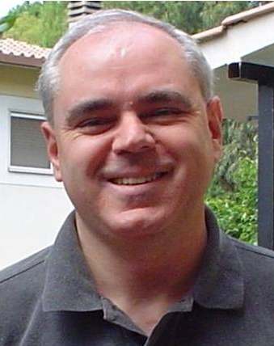

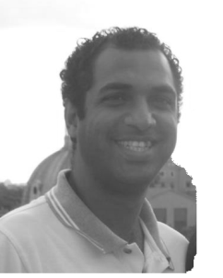
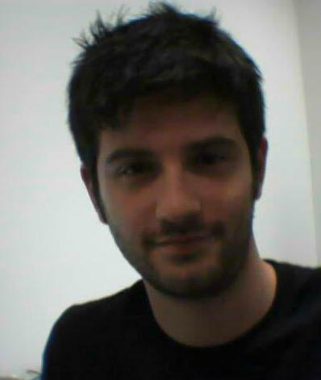

TiberCAD people
Prof. Aldo Di Carlo
Dr. A. Pecchia
Dr. M. Auf der Maur
Multiscale Device Simulator
http://www.tibercad.org
Dr. A. Gagliardi
Dr. F. Sacconi
Mr. F. Santoni
Mr. W. Rodrigues
Dr. G. Romano
Dr. G. Penazzi

Slide 4
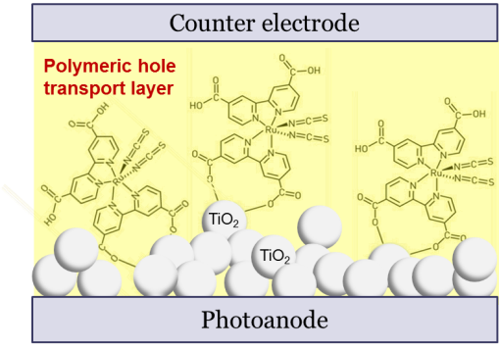
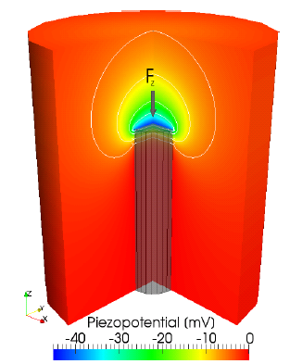
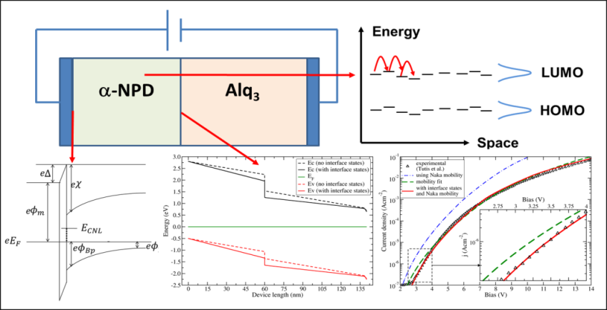
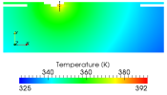
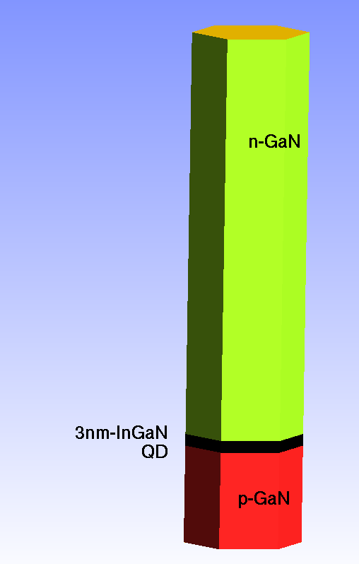
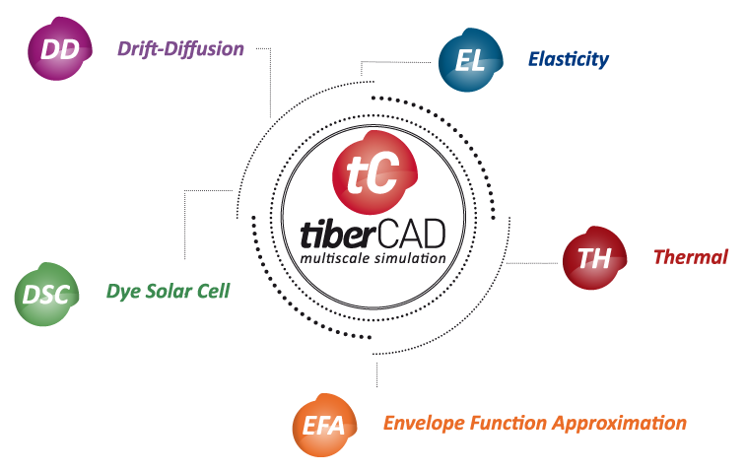
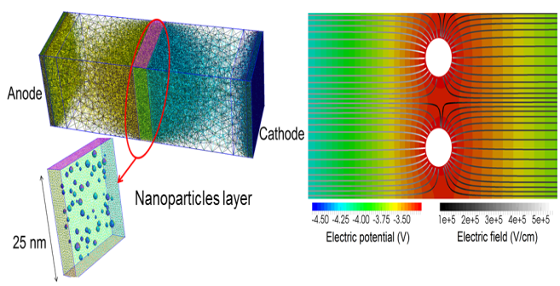
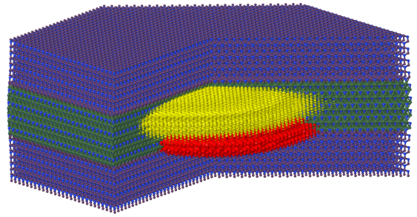
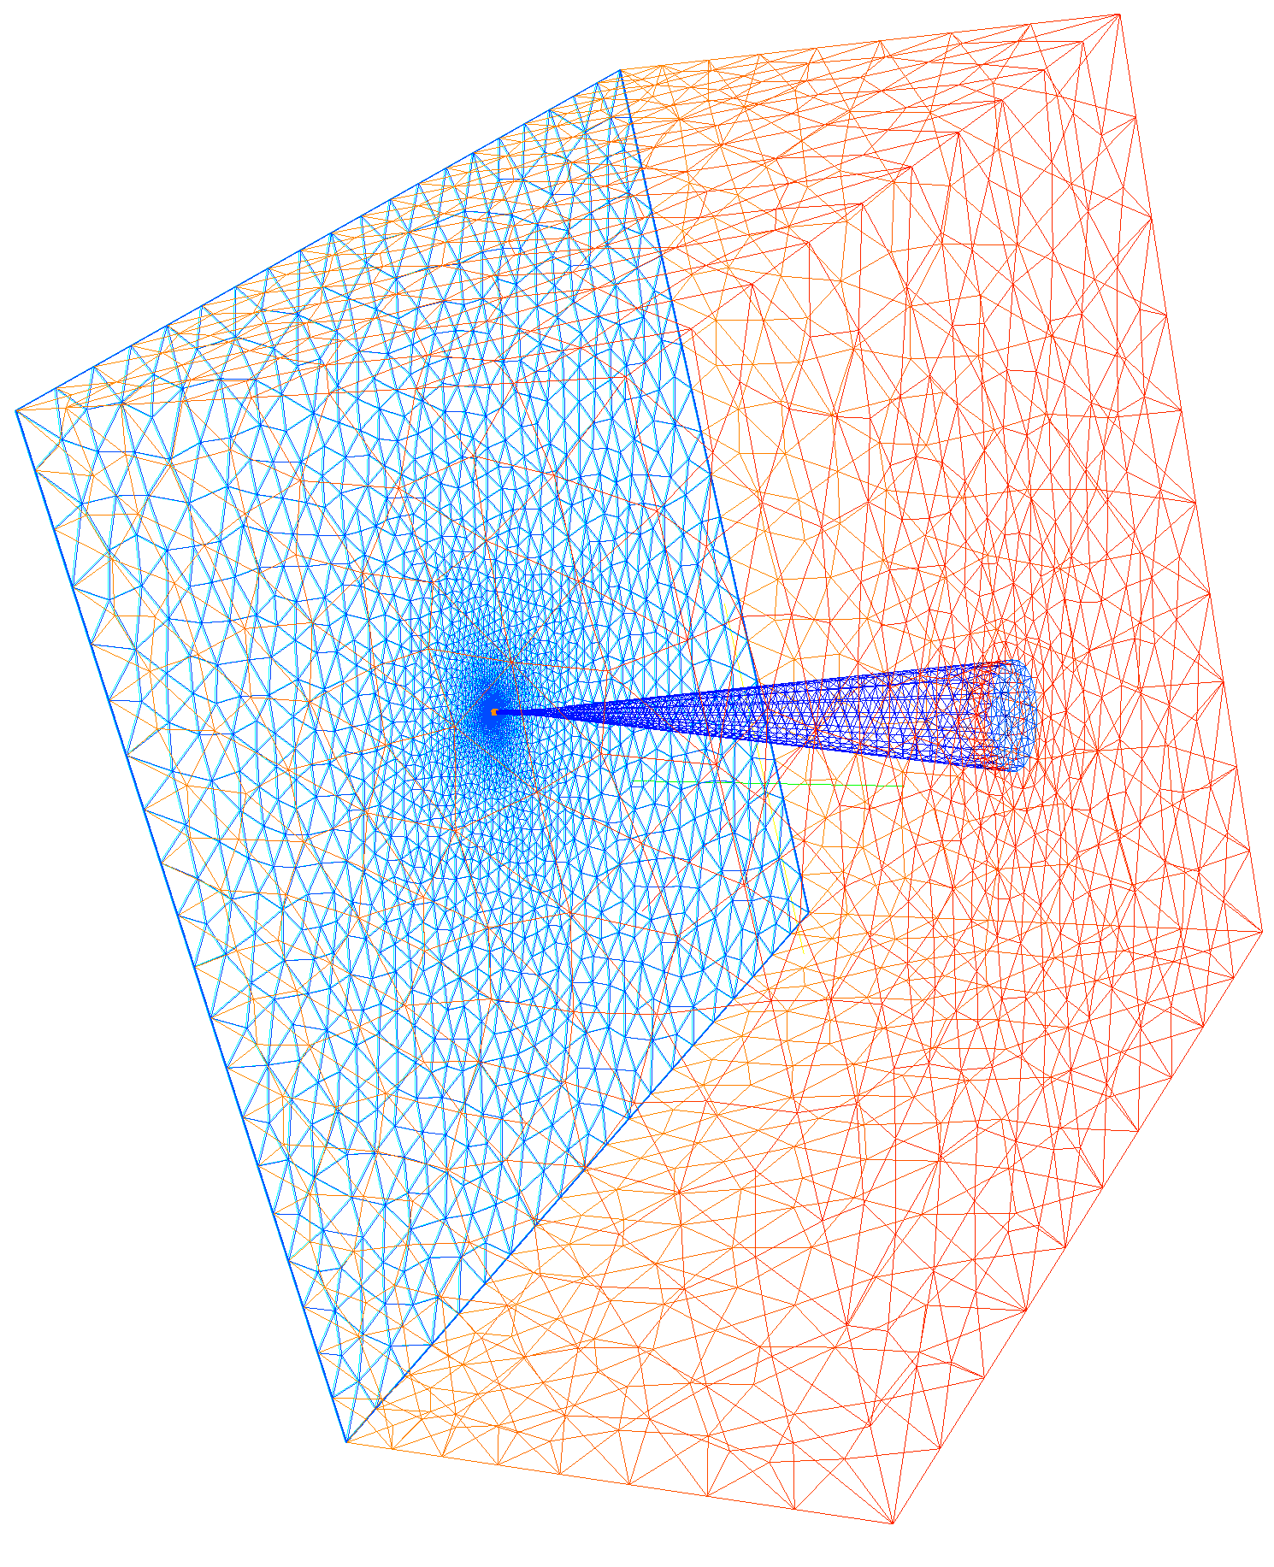
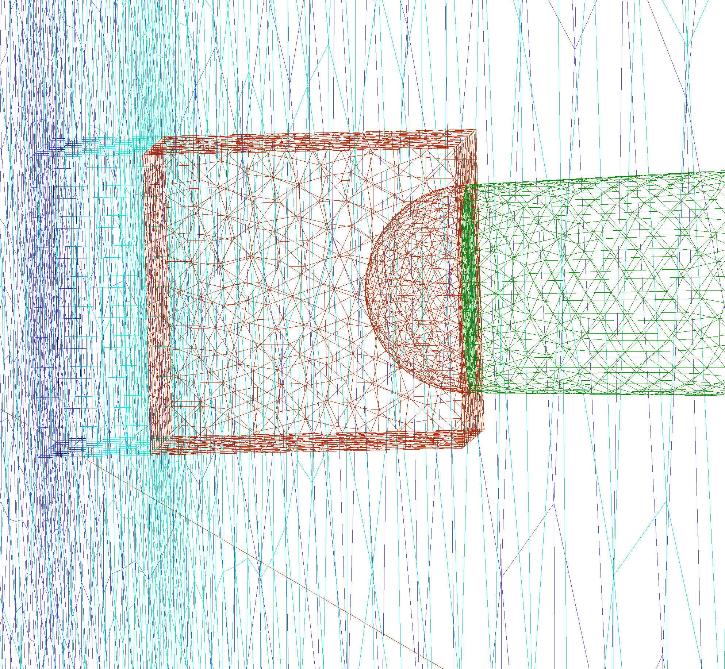
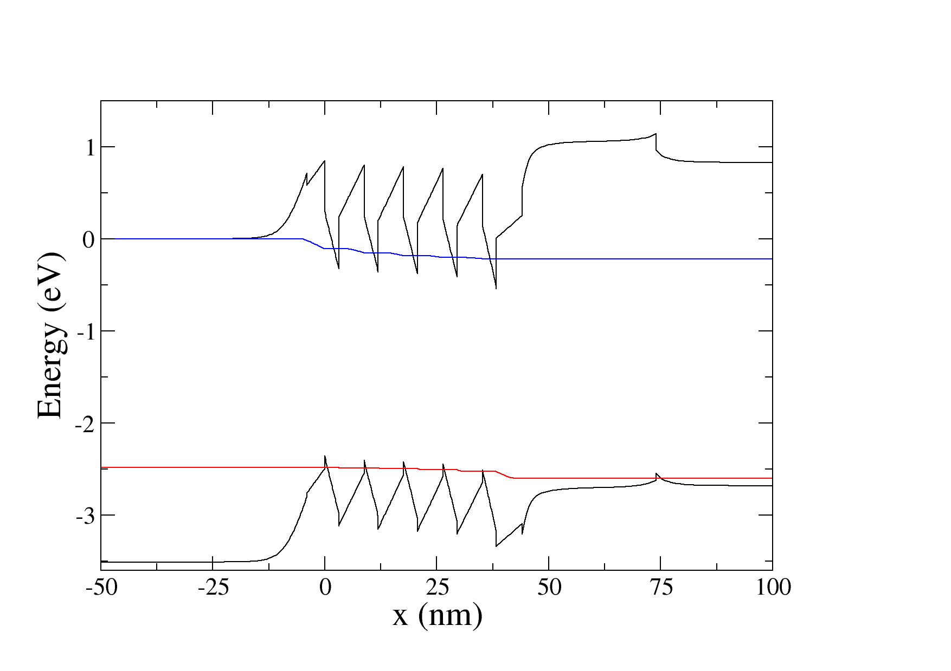
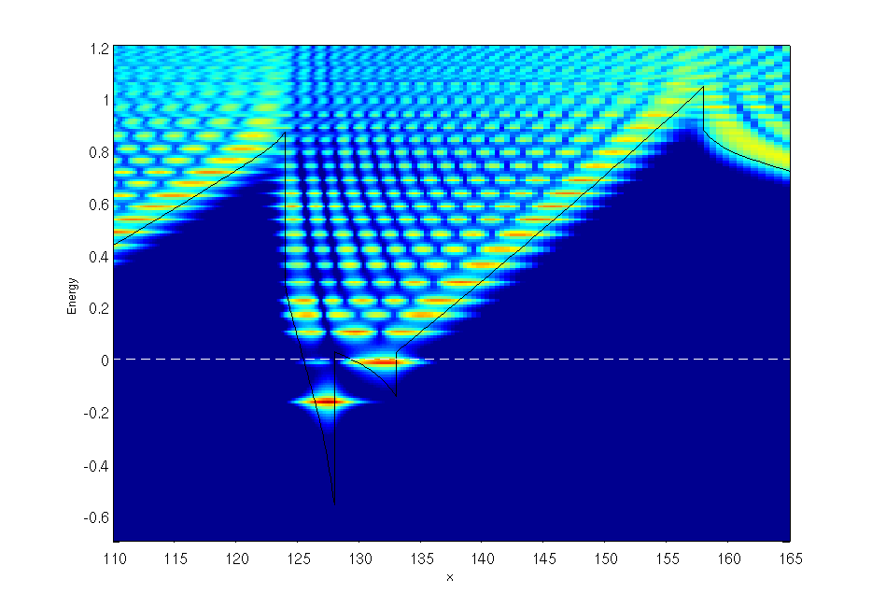
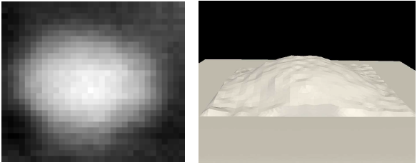
Applications
DSSC/OPV module
Piezoelectricity
Charge transport in organic semiconductors
Heat dissipation
Memristors
Nanofilaments
Inorganic LED (InGaN)
Quantum DOTs
1 nm
300 nm
Contact
Tunnel distance

Slide 5
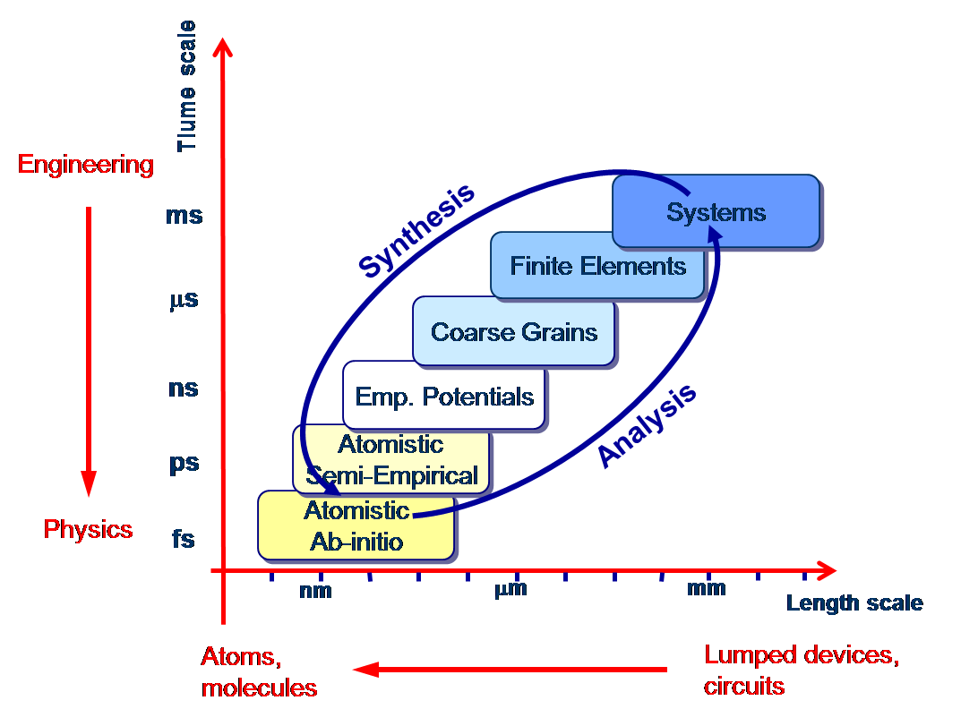
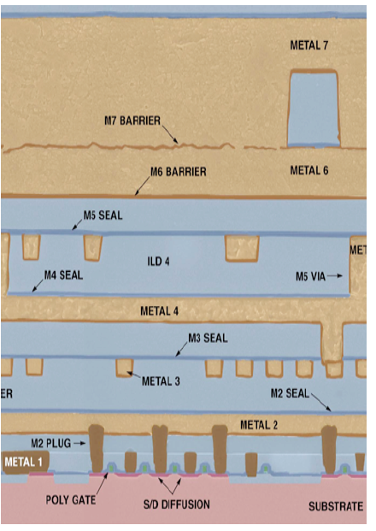
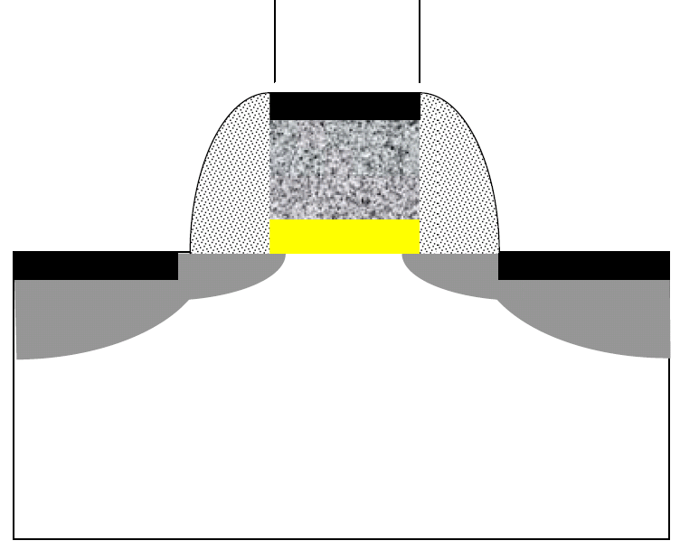
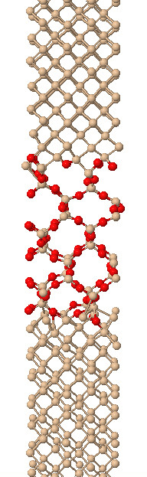
multiscale/multiphysics
Different physical models on different scales are needed to describe electronic devices
Package Level
Device Level
Strain
Atomistic Level
QM regions
Poisson/Drift Diffusion

Slide 6
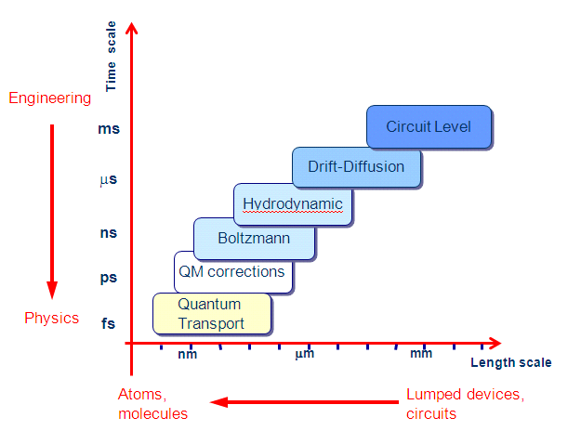
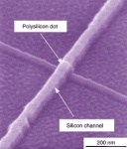
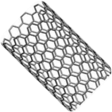
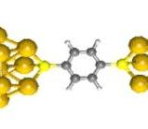
Introduction: TiberCAD
1 A
1 nm
10 nm
100 nm
1 um
Features:
drift diffusion, strain, thermal, EFA
VFF, ETB, DFTB
Organics, DSSC modelling.

Slide 7
Models overview
Elasticity
ε_{μν}
converse
piezo
Classical Regions
Drift-Diffusion
Thermal
Finite Elements
E_{c} ,E_{v}
ϕ
|ψ|²
Env. Funct.(k⋅p)
elasticity
guess
Valence FF
Quantum Regions
structure
Atomistic
Empirical TB
DFTB

Slide 8
Multiscale/multiphysics schemes
OVERLAP METHOD
o
each model computes physical quantities that act as parameters to the other models.
domain 1
domain 2
Schrödinger/Poisson
Transport parameters from DFT
BRIDGE METHOD
each domain provides boundary conditions to adjacent domains.
DOMAIN 1
DOMAIN 2
NEGF/drift-diffusion
VFF/continuous elasticity
M. Auf der Maur, G. Penazzi , G. Romano, F. Sacconi, , A. Pecchia , A. Di Carlo
IEEE Trans. Electron Devices, 58, 1425 (2011)

Slide 9
Overlap Multiscale
Schrodinger + Drift Diffusion

Slide 10
Energy/Position Multiscale
Energy
Drift-Diffusion Transport
Classical density
Quantum density: ETB
Min CB
Max VB
Quantum density: K.P
Position
n-AlGaN
GaN
p-AlGaN
Active region

Slide 11
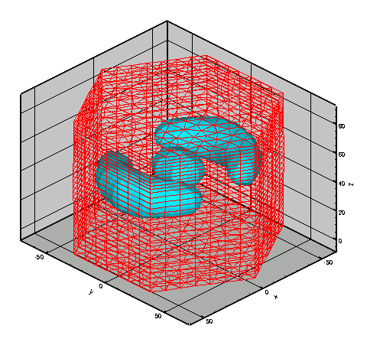
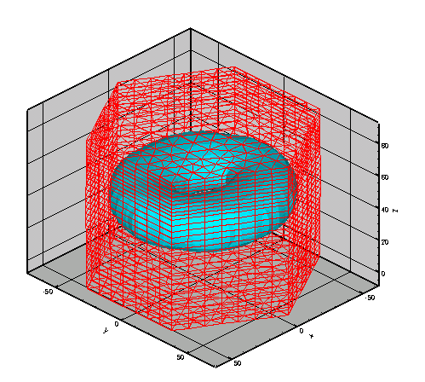
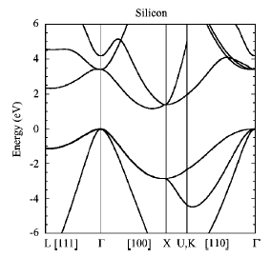
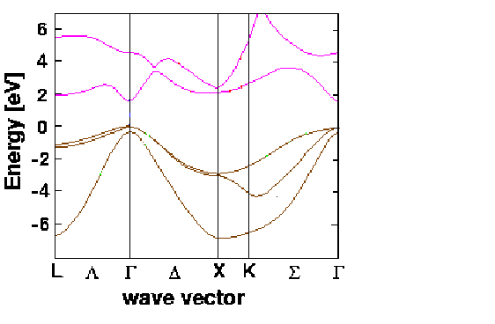
Envelope Function Approx
k⋅p Hamiltonian generalizes single band dispersions
Envelope function
k is interpreted as the usual momentum operator:
In TiberCAD:
Full Band kp
Cardona-Pollak (1966)
G. Fishman (2004)

Slide 12
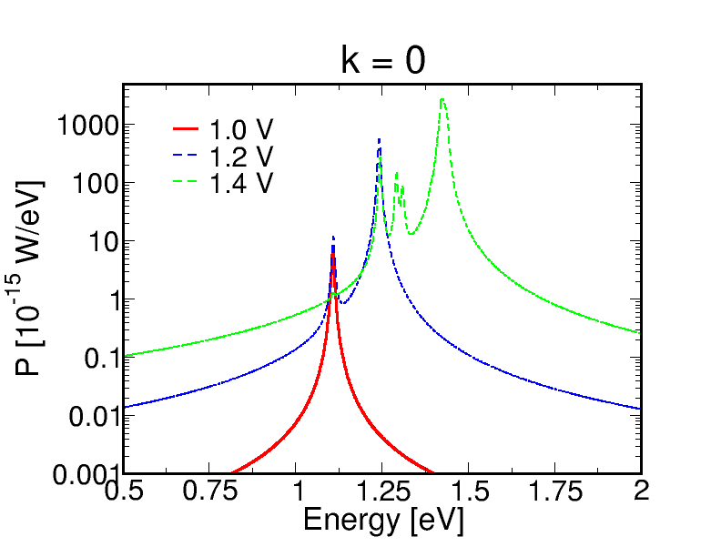
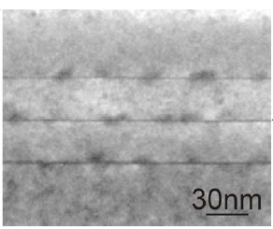
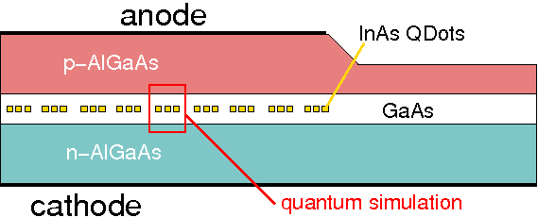
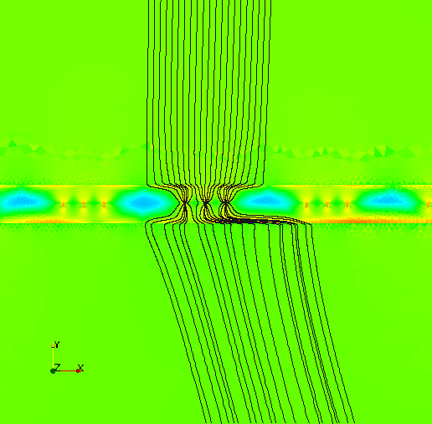
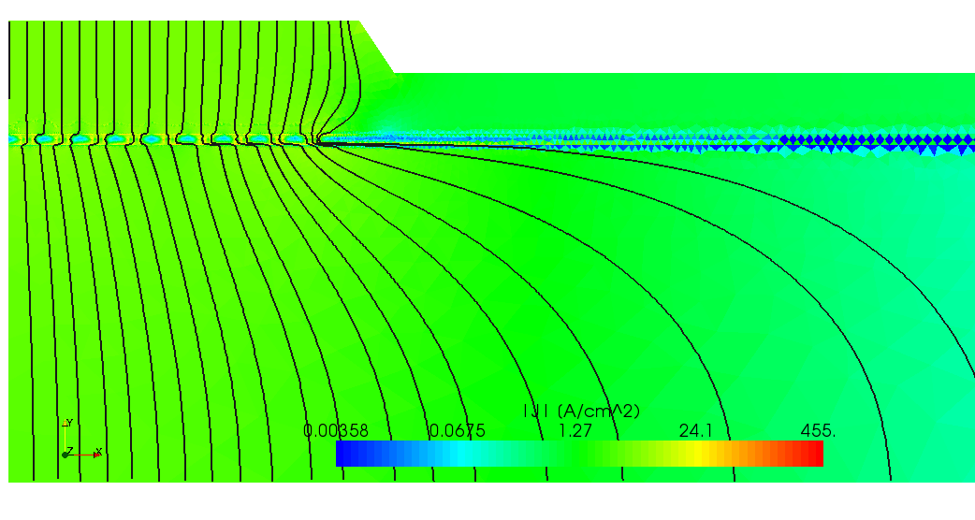
InAs Qdots
M. Buda et. al., IEEE Journal of Quantum Electronics, 2003

Slide 13
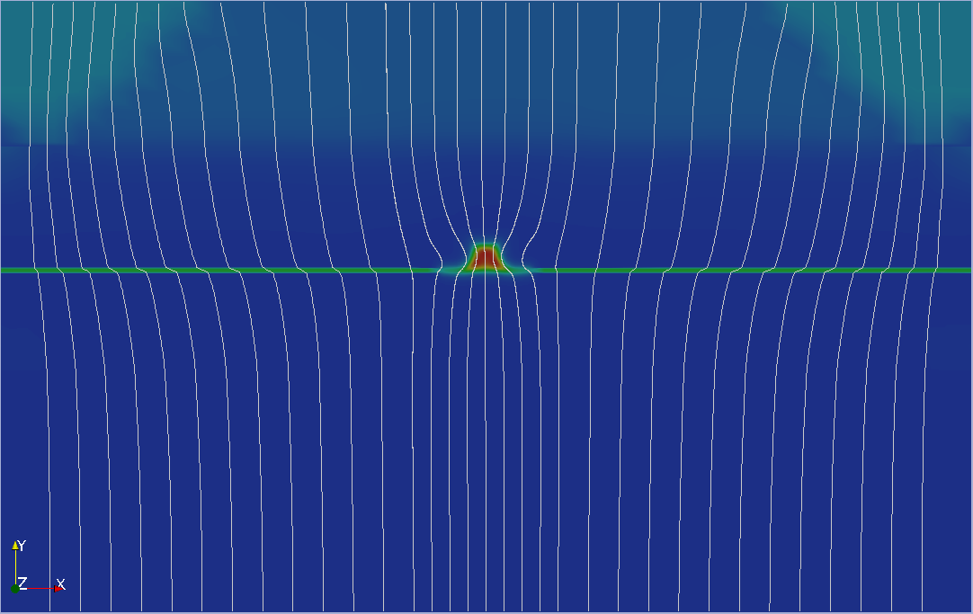
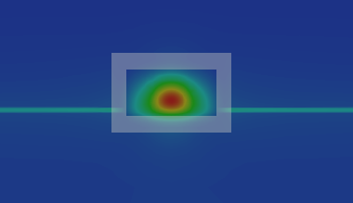
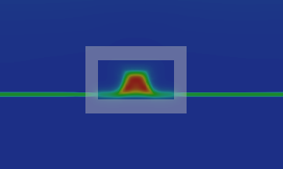
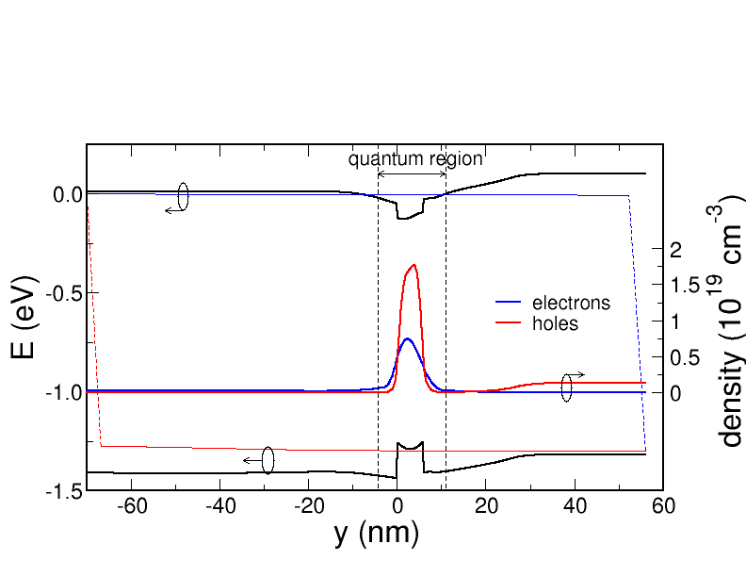
InGaAs Quantum wire: overlap scheme
anode
quantum region
electrons
current crowding in the wire
embracing
cathode
holes
Self-consistent densities at Vb = 1.3 V
K.P quantum model
Notes:
13

Slide 14
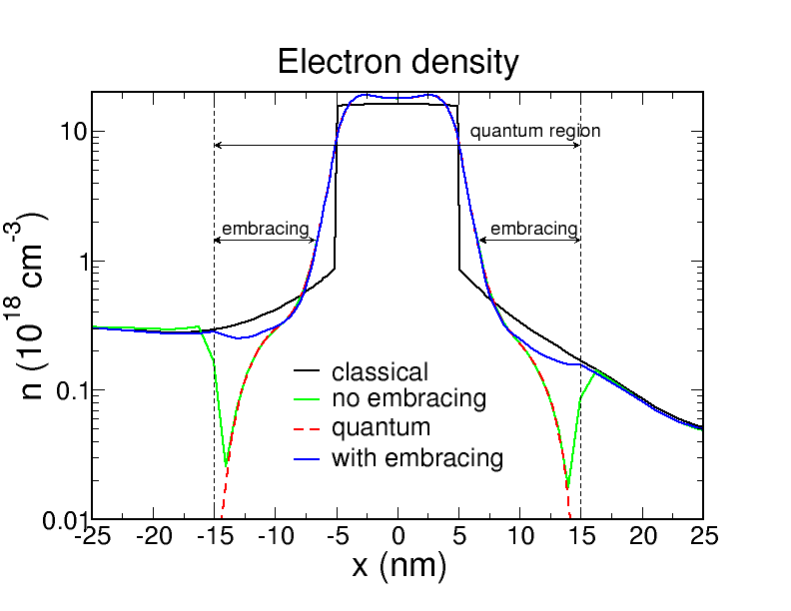
Embracing technique
TiberCAD includes a technique for mixing classical and quantum density, acting as a quantum correction to drift-diffusion calculation
Embracing region where classical and quantum charge are mixed.
The mixing parmeter is solution of a Laplace equation with Dirichelet boundary conditions 0.0 and 1.0

Slide 15
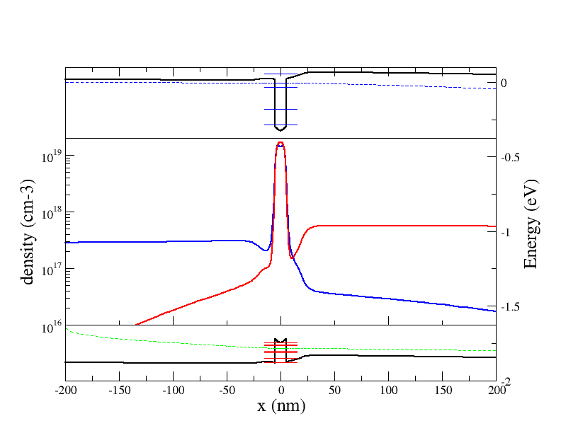
Alternative: Quantum+Classical
Barrier and well embracing: Well is quantum + classical

Slide 16
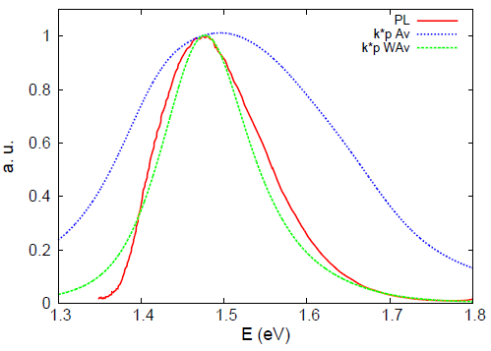
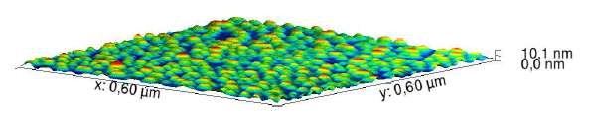
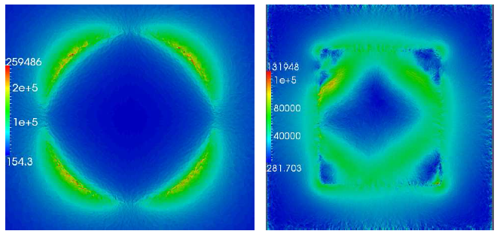
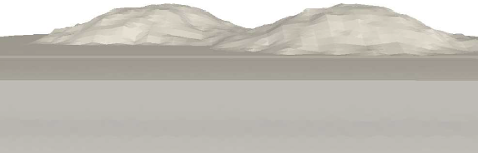
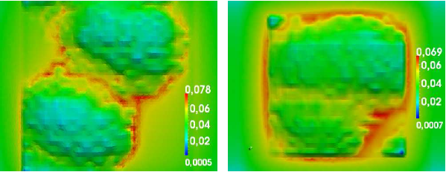
InP dots for gas sensing
AFM image:
Idealized dot
Realistic dot
Strain field maps
D. Barettin et al. Nano (2014)
Closely coupled dots
D. Barettin et al. J. Appl Phys (2015)

Slide 17
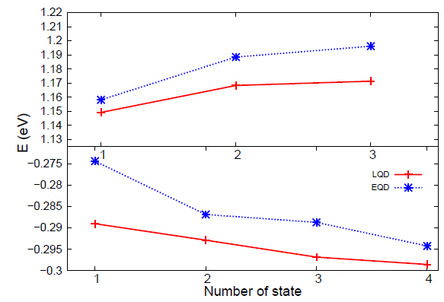




Electronic properties
Electron states
Hole states

Slide 18






Comparisons between dots
homo-nuclear dots
el:
hl:
hetero-nuclear dots
el:
hl:

Slide 19





Shape and alloy effects in Qdot system
EBL
Qdots (islands)
TEM image (In comp.)
Imported alloy concentration
Strain profile
≠
Constant In concentration

Slide 20



Lateral coupling via strain
Impact of lateral coupling given mainly by strain field (continuum and k*p 3D model): shift of the spectrum of the central dot of about 90meV

Slide 21




Current densities
electron current density
Hole current density
Increasing electron current density with electron-rich layer

Slide 22
Quantum Transport: NEGF
Bridge Multiscale

Slide 23
Models overview
Elasticity
ε_{μν}
converse
piezo
Classical Regions
Drift-Diffusion
Thermal
Finite Elements
E_{c} ,E_{v}
ϕ
|ψ|²
j
Env. Funct.(k⋅p)
elasticity
guess
NEGF
Valence FF
Quantum Regions
structure
Atomistic
Empirical TB
DFTB

Slide 24
Open quantum systems
Left Lead
Right Lead
Effective Scattering Region

Slide 25







libNEGF
Continuous
Quantum-classical interfaces
Atomistic
libNEGF
phonons
http://www.bitbucket.org

Slide 26




NEGF: contact generation
N-1 dimensional Contacts
Automatic mesh creation using libMESH classes
General extrusion of planar contacts in 1,2,3D

Slide 27

Example: MOS with NEGF
Mix between overlap (Schrödinger/Poisson) and bridge (current at NEGF boundary) schemes
25 nm
S
D
drift-diffusion
Fully self-consistent
NEGF

Slide 28
NEGF: input file
S
D
Module negf{
regions = channel
Physics{
Hamiltonian efa {}
}
}
Module selfconsistent
{
solve = (negf, driftdiffusion)
Multiscale bridge {
macromodel = driftdiffusion
micromodel = negf
restrict_variables = (fermi_e)
}
max_iterations = 10
absolute_tolerance = 1e-3
relative_tolerance = 1e-9
}
In negf regions, solve only for
electrostatic potential,
(not for electron current)

Slide 29





MOS: quantum/classical
V_{g} = 0.1-0.7 V
density
z (um)
x (um)

Slide 30








RTD devices
RTD structure
0.2 V
0.5 V

Slide 31

InGaN/GaN multi QW
injection
spontaneous emission
Peculiarities:
Strong built in field due to spontaneous and piezoelectric polarization (wurtzite crystal)
Large injection barriers
Deep acceptor donor level
nonradiative losses
Trap-assisted tunneling
$$IQE=\frac{radiative rec}{radiative rec+nonradiative rec.}$$

Slide 32


Motivation: why InGaN/GaN
Tunable gap across visible: high efficiency/efficacy LEDs
Theoretically could allow for all-nitride phosphor-free white light
Challenge: InN GaN are 10% lattice mismatched !
Kaun et al, Semicond. Sci. Technol. 28 074001,2013
VCA

Slide 33

InGaN/GaN specific issues
InGaN/GaN QW LEDs suffer from two severe efficiency issues
The reasons are not well known yet: simulations as helpful tool
  ⇒ Efficiency droop:
  ⇒“green gap”:
peak emission efficiency
Source: generalwafertechnology.com

Slide 34




Example: excited states
Here we use NEGF to calculate the LDOS, on top of a DD simulation (no selfconsistency)
NEGF based LDOS give more insight into spatio-spectral features
«standard Schrödinger» approach is less efficient
Future:
Photogeneration from el-γ coupling will allow to asses importance of leakage in PL experiment
2 nm QWs
2 nm QW
Energy
4 nm QW
4 nm QWs
position

Slide 35


Difficulties
Difficulties: separate n/p densities near equilibrium
Below knee voltage the minority carrier densities become extremely low
Reproduce non-radiative recombinations in NEGF (Auger, SRH)
Introduce el-γ coupling in NEGF
Energy
Log(occupation)
Position (nm)
work in progress

Slide 36



Importance of non-radiative losses
Forward current at low injection, for different devices (different QW thickness, different In content)
Correlation between fitting parameters and independent mechanical data

Slide 37
Coupling atoms with finite elements
Tiume scale
ms
Classical transport
Finite Elements
μs
Quantum Devices
ns
Atomistic
Semi-Empirical
ps
Atomistic
Ab-initio
nm
μm
mm

Slide 38
Atomistic structure generation
We can assure a consistent atomistic structure using a top down approach:
1. Identify relevant volume
2. Shift origin slightly inside
3. Fill up with atoms using the crystal basis
4. Cut atoms outside of the structure

It is important that all atoms are lying inside the simulation domain
Δr

we assume pseudomorphic structures with commensurate interfaces

Slide 39


Valence Force Field
We included a Keating model to calculate strain at an atomistic level
The equilibrium position is that one which minimizes U
We use a nonlinear conjugate gradient minimization technique
Keating (1966)
D. Camacho, Y. M. Niquet (2009)
Penazzi Gabriele, PhD. Thesis (2010)

Slide 40



VFF vs Elasticity
Evaluating when Continuum Elasticity failures is not trivial.
It depends on structure geometry. In general, it fails near interfaces
InAs quantum dot on GaAs substrate
Self assembled by strain relaxation
High lattice mismatch (about 7%)
15% differences

Slide 41





VFF vs Elasticity II
Smaller differences on low aspect/ratio structures
Increase height up to 5 nm
VFF is fundamental also to
include internal strain here!

Slide 42
Empirical Tight Binding
φ= orbital
C_{iα}
Ψ
matrix notation:
HC=EC

Slide 43




Empirical Tight-Binding
The sp³s* Hamiltonian
[Vogl et al. J. Phys. Chem Sol. 44, 365 (1983)]
The sp³d⁵s* Hamiltonian [Jancu et al. PRB 57 (1998); PRB (2001)]
GaN

Slide 44
Alloys

Slide 45

Alloys
Can treat alloys in two ways: VCA (virtual crystal approximation, effective material) or ‘real’ structure (e.g. random alloy)
  In VCA matrix elements are taken as mean values:
    In_{x}Ga_{1-x}N = x*(InN) + (1-x)*(GaN)
  otherwise onsite elements according to the atom and hopping element according to the pair
VCA:
InGa
‘real’:
Ga
InGa
InGa
In
Ga
N
N
InGa
In
requires supercell + statistical ensemble
Note: we like parameter sets where the common atom (N) is consistent between InN and GaN

Slide 46

Modelling nanopillars
small footprint on the substrate, allows:
defect-free material
growth on various substrates (Silicon)
growth on large area substrates without lattice strain
Empirical Tight binding model sp³d⁵s*+SO
Solve few states using Lanczos
M. Auf der Maur IEEE TED (2011)

Slide 47


InGaN nanocolumns
51714 Atoms Strained + VFF x(In=0.10).xyz
GaN
2.071nm
InGaN
2.117nm
GaN
2.073nm
|---9.464nm---|

Slide 48

InGaN nanocolumns
51714 Atoms Strained + VFF x(In=0.20).xyz
GaN
2.066nm
InGaN
2.159nm
GaN
2.073nm
|---9.534nm---|

Slide 49

InGaN nanocolumns
51714 Atoms Strained + VFF x(In=0.35).xyz
GaN
2.061nm
InGaN
2.221nm
GaN
2.074nm
|---9.653nm---|

Slide 50

Modelling nanopillars
14 nm
  VCA
  Random uniform
  Random with clustering
GaN
10 nm
GaN
InGaN
2 nm
GaN
Uniform distribution is first applied to the structure (e.g. 70% uniform and 30% clustering)
Probability of Substitution of a Ga atom in GaN with In is higher if other In atoms are already in a sphere of 1nm radius around the atom.

Slide 51




Modelling nanopillars
No clustering
30% clustering

Slide 52


ETB groundstates
No clustering
el
hl
30% clustering
el
hl

Slide 53




VFF and elasticity models
ε_{xx} strain from elasticity macroscopic model (VCA)
xy plane in the InGaN region
VFF on a VCA structure
VFF on a random sample

Slide 54


Effects of clustering
Strain from VFF on a random sample
uniform distribution
clustering

Slide 55




Optical Spectrum – no clustering
In 10%
In 30%
FWHM = 18 meV
FWHM = 35 meV

Slide 56




Optical Spectrum – 30% clustering
In 10%
In 30%
FWHM = 20 meV broadening
FWHM = 45 meV broadening
Distribution of energy gaps
Mean = 3.329
Std = 0.0278
skew = -1.242
Distribution of energy gaps
Mean = 2.793
Std = 0.028
skew = -0.708

Slide 57


Correlation between ground state transition energy and optical strength
Increasing spread in random distribution with higher x(In)
VCA overestimates Et and Opt.strength
  Clustering effect:
  Larger spread in random distribution
  Lowering of mean Et

Slide 58




Localization behavior in InGaN QW
Correlation of local In concentration with wave function localization
Electrons and holes subject to different In fluctuations planes
min. |M|
el, hl
max. |M|

Slide 59




Effect of non-uniformity
Theory for uniform alloy
counts
Environment dependent substitution probability
uniform
70% uniform
Local In concentration
QW:
40% uniform

Slide 60



InGaN QW: optical matrix element
Lateral localization leads to strong fluctuations in optical matrix elements
Fluctuation both in energy and M, icreasing with In concentration
Correlation between E_{g} and MME
25% In
Increasing deviation from VCA values

Slide 61





CUDA developments
1,000,000 atoms on a WS!
Lambda state
W. Rodrigues, A. Pecchia, A Di Carlo, Comp. Phys. Comm. (2014)

Slide 62
Software Development ToolKit

Slide 63
Software Development toolKit
⇒ Allows to add new modules by user without relinking core
Module somename
{
Physics {
mobility constant { }
}
}
library name somename.so
library name mobility_constant.so
TiberModelObject
Handles instantiation from shared libraries, option container, basic functionality
SimulationInterface
PhysicalModelInterface
PhysicalObject
Module driftdiffusion
{
}
Physics {
mobility constant { }
}
Base class of all physical entities
bulk, interface, edge, node

Slide 64
Example: Poisson
Module poisson {
Physics {
charge_density constant {
}
}
}
#include "SimulationInterface.h"
class Poisson : public SimulationInterface
{
public:
static Poisson* create(options);
protected:
virtual void do_init(void);
virtual void parse_options(void);
virtual void do_setup_solution_variables(void);
virtual void do_solve(void);
virtual PhysicalModel* create_bulk_model(options, material);
virtual PhysicalModel* create_boundary_model(options, boundary);
virtual void get_solution_secure(element, data, points);
private:
};

Slide 65

Conclusions
Multiscale/multiphysics is requested for simulation of real modern electronic devices where electronics, optics, chemistry are linked together
We have seen the most important physical models implemented in tiberCAD
We have discussed the basics of how to couple atomistic and classical simulations
Much effort is still needed to arrive at a true multiscale integration for transport simulations
Additional info about TiberCAD: http://www.tibercad.org
Download free trial version:
www.tiberlab.com
info@tiberlab.com

Slide 66
THANK YOU !

Slide 67


Transport across EBL
tunneling across Al_{0.2}Ga_{0.8}N EBL:
RND
<RND>
VCA
Considerable fluctuations due to random alloy: similar to defect assisted tunneling

Slide 68


Inter-well transport in LED
tunneling across In_{0.05}Ga_{0.95}N barrier:
Extracted barrier resistivity:
Pure drift-diffusion: 15 Ωcm²
8 band k⋅p: 1.33 Ωcm²
Random alloy: 0.28 – 1.26 Ωcm²
⇒ More realistic ON current:

Slide 69




Oxide-tunneling
Coupling DD with
balistic tunneling,
quantum density
β-critobalite
tridimite
β-quartz
Sacconi et al IEEE TED 2004 and 2007
M. Auf der Maur et al. J. Comp. Elect., 7 398 (2008)

Slide 70

Bridge method: flux continuity
Y
G
λ
Poisson-Drift-Diffusion is solved in the whole device
S
J^{C}(λ) = J^{Q}(λ)
D
J^{C},V(x,y)
X
Self
consistent
cycle
Y
G
λ
Tunneling current calculated with atomistic tight-binding model is taken as a boundary condition for electron continuity at Si/oxide interface
S
J^{C},V(x,y)
D
X
Notes:
70
Let’s consider an example fitting to the first case.
Here we have a MOS, source, drain and gate. Here we have the oxyde. The oxyde, treated classically is a ideal electrical insulating but we know that quantistically not. We know that across this junction flows the tunnelling current. One could think to adopt a quantum-mechanically approach everywhere but the computational cost becomes too large. The idea is, therefore, using two different approach for each domain.
And what do it happen along this interface? Our idea is imposing the continuity of the density current.
Let’s briefly see the proposed algorithm which accomodates this condition.
Let’s assume a local coordinate landa in this way. We assume that, at the first step the quantum current is zero. We solve the drift diffusion simulation which gives the electrostatic potential turned out along the oxide interface. This potential is the boundary condition for the quantum
simulation which in own turn computes the quantum current through some quantum transport simulation (Empirical Tight Bindind, Density Functional Method or whatever). This current becomes the new boudnary condition for the drift diffusion simulation and so on.
70

